Slide 1
Winter flu and NHS 111 First
20th October 2020
Healthwatch Kingston open meeting
Hannah Keates – Engagement Manager (Kingston & Richmond)
Notes:
Thank you for inviting me to talk to you today
Introduce me
I’m going to cover a couple of items – firstly the NHS winter flu campaign and how that is being translated and rolled out locally
Then talk about Think NHS 111 First, which is a new campaign where people who need urgent NHS care will be asked to call NHS 111 before deciding to walk in to A&E.

Slide 2
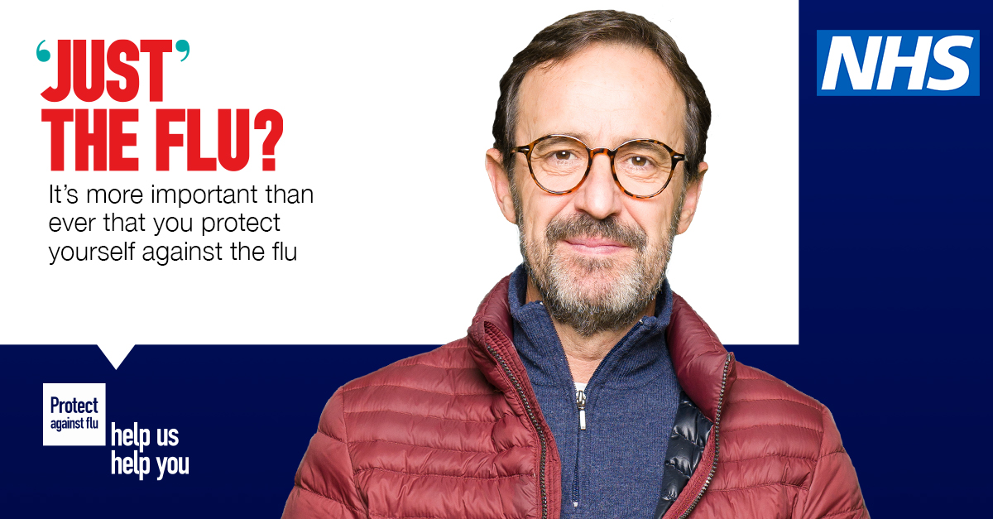
Flu campaign
Notes:
Talk now about the NHS winter flu campaign, which is more important than ever this year with Covid 19 also circulating.
For SWL we have adapted the national NHSE campaign materials to resonate with local audiences as well as helping to target our outreach community engagement work.

Slide 3
Target audiences
 | Cohort
Top priority | Under 65s at risk
 | 2 – 3 year olds
Other eligible groups | Pregnant women Over 65s
Activity across all boroughs for harder to reach groups | Local people with learning disabilities
 | Local people from BAME communities
Notes:
Feedback from the local accident & emergency delivery board and the SWL flu group agreed these priority target groups from the national extended eligible cohort list to shape activity in the borough and alleviate local pressures.
So in Kingston these are …….
Across SWL we are also targeting in our comms local people with LD and BAME

Slide 4
Insight work with thousands of local people
Flu attitudes and intentions survey : 3,814 responses
Borough health and care partners/PPE leads1,563
Social media1,471
Our ‘SWL Citizens Panel’ across 6 boroughs 439
Additional targeted response from BAME groups 341
Flu attitudes and intentions outreach engagement work
In-depth discussions with people from BAME communities and those with learning disabilities. 41 sessions involving 331 people across 6 boroughs. Groups included:
BAME forums and groups Local Mencap groups BAME focus groups 1-2-1 interviews (LD and BAME) | Faith organisations Local patient engagement groups, SEND and parent groups Voluntary sector representatives and Healthwatch.
Notes:
Across SWL we carried out insight work to help us develop a clear and effective campaign. We ran a survey to help us understand more about what local people think about the winter flu vaccination and also talked to target groups in each borough, to adapt the national campaign materials to resonate with local audiences.
With the outreach work we spoke to 11 BAME forums & groups, 10 LD, 3 CYP/parents groups, 3 carers groups and also general patient groups, older people and residents groups
In Kingston of the 3814 people across SWL, nearly 14% were from Kingston, which was the second highest after Richmond.
From the survey responses it showed an under-representation of BAME communities in the survey responses – 2011 Census says 43% of residents in SWL BAME, in total 24% of respondents described themselves as being non-white British.
In Kingston BAME response (those stated not white British)
28 Asian or Asian British
5 black or black British
12 mixed or multiple ethinc groups
10 other
38 white other ethnic group
We carried out a focus group with representatives from BAME communities and voluntary groups from Kingston & Richmond to hear their views on the flu jab and help us focus our comms campaign locally. Covered why people choose to have, or not have the flu jab.

Slide 5
Persuading local people get a flu jab
Based on extensive engagement with local people we know the key motivators and blockers behind the decision to get the flu jab
Motivators
Protect self and others
Covid-19 has made me more aware of the seriousness of flu/potential benefits of vaccination
Reduce impact of coronavirus
Don’t want flu and COVID-19 together
Want to protect self and others
Relieve pressure on NHS
I’m pregnant/at risk
Children as super-spreaders/very sociable
Now eligible
Blockers
Concerns about side effects/became unwell
I’m healthy, take vitamins, don’t need it
Not eligible
Not at risk
Fear of needles
Don’t want a vaccine
Concerns about vaccination/toxins
Notes:
This is a summary of all the feedback from our engagement showing the motivators and blockers behind the decision to get the flu jab
Highlighted some of the key ones

Slide 6
BAME – motivators and blockers in detail
Motivators
Reducing the need to take time off work
Belief in science
Had flu before and don’t want to risk getting it again
Don’t want to risk Covid + flu
At an age where it is recommended
Protecting: health, the vulnerable and people at work
Important and responsible behaviour
Need to be well to care for children or vulnerable adults
Suffer from asthma, COPD, other respiratory illness/Pregnant
Recommended by GP
Reduce burden on the NHS
I might have it if…
My GP advises me to/I’m offered it
It’s free
I have the time to get it done
I’m reassured it’s safe/I know more about it
I know there’s enough to go around
Notes:
This is some of the detailed feedback we received specifically from respondents from BAME communities about what would motivate to have a flu jab

Slide 7
BAME – motivators and blockers in detail
Blockers
Don’t know about eligibility
Feeling healthy/eat well/have a good immune system
Forgot/didn’t get round to it/don’t have the time
Allergic to ingredients/vegan/can’t have pork
It’s not safe/it contains toxins
It contains swine flu or Covid vaccine/it’s being used to experiment on people
Covid adversely impacts BAME people, does the flu vaccine likewise have BAME specific side effects
Have never had the flu
Previously had side effects/it causes flu
Can’t afford it
Not eligible or in ‘at risk’ group
Prefer home remedies/building natural immunity
Didn’t want to take up vaccine needed for others
Asylum applicants and others with no recourse to public funds–can they have the vaccine? Might not be registered with a GP
Notes:
Detailed feedback on the blockers for BAME communities

Slide 8
People with a learning disability – motivators and blockers in detail
Motivators
Encouraged by support network
Underlying health conditions
Have it at the same time as a Health Check
Understand that vaccines are good to have
Don’t want to get flu
Carer has positive attitude to vaccination
Blockers
Don’t like needles
Worried about catching Covid by going outside/to GP
Worried about side effects/becoming ill
Some carers of vulnerable adults were against the idea of vaccines. However, these were in a minority compared to carers favourable to vaccination.
Notes:
For people with a learning disability, these are the key motivators and blockers

Slide 9
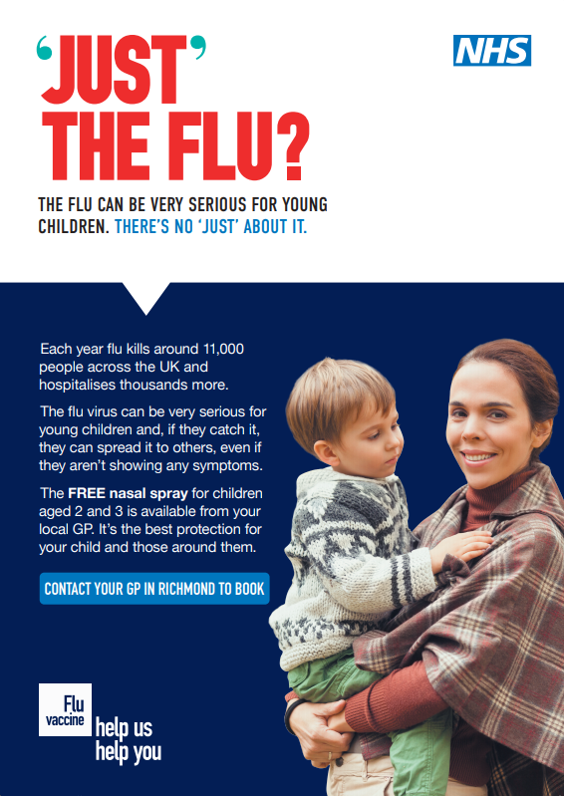
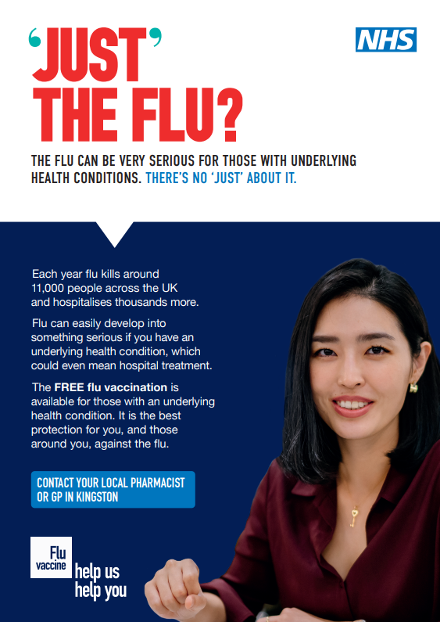
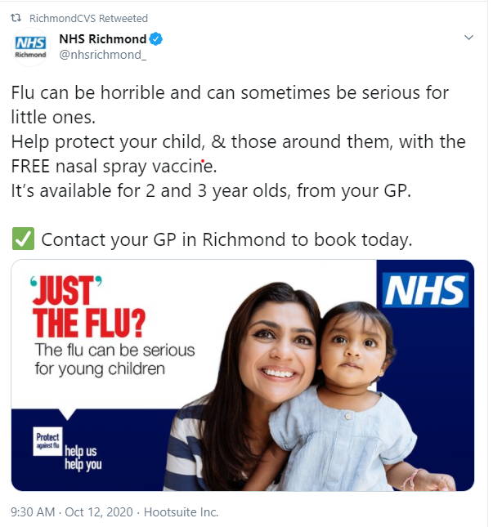
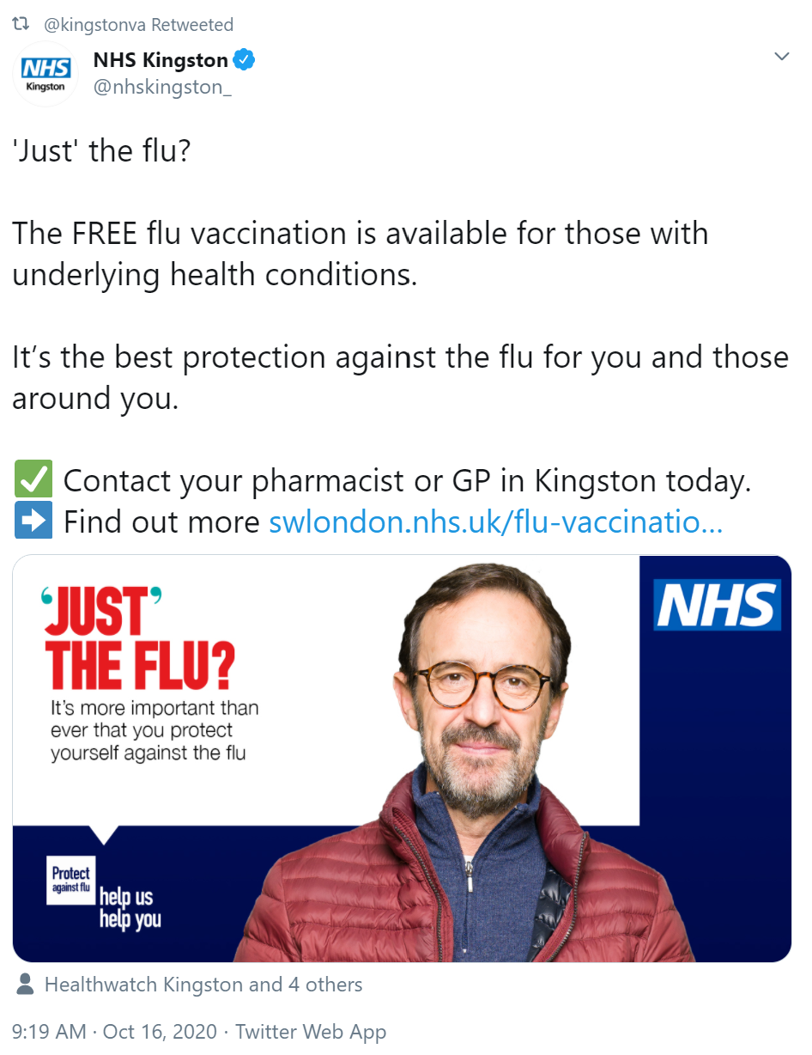
Please share our messaging on social media and in person
bit.ly/RichmondFluKit
bit.ly/KingstonFluKit
Thank you for sharing already
Notes:
We’ve produced a toolkit to promote the importance of people getting vaccinated.
To ensure we’re reaching the those within our demographics, as well as their friends and relatives, we’ve designed a range of multi-media assets which educate local residents, encourage behaviour change and think of those most vulnerable to flu.
This toolkit contains a variety of assets and suggestions of how we can maximise these as part of the communications mix. These are links to the Richmond and Kingston toolkits which contain digital assets to target the priority groups – text and images for use on Facebook, Twitter, Instagram etc
Also a downloadable poster for printing

Slide 10
Content and collateral
SWL Flu Campaign – Localised echoing the national NHSE Flu campaign
Digital toolkit and digital/video materials
SWL Flu campaign e toolkit -all assets bespoke for each borough
Social media and digital materials for each target group for organic and targeted paid
advertising (parents of 2 3 year olds, BAME communities, LD, under 65 at risk, 50 64,
pregnant women and Over 65s)
Myth busting films
Myth busting materials
Templates, presentations and stock content
Standard stakeholder support letter with toolkit –asking for support with materials and suggestions.
Standard internal communications for health and care staff – adapted by each organisation to resonate with their employees
Key messages, narrative, media releases, content schedule
Print
DL myth-busting leaflets in a number of translated languages
A3 posters for NHS settings and community outreach work + translations
Notes:
Myth busing films:
Top myths segmented per cohort with a range of clinicians and participants across
SWL:
1 x short film myth busting for under 65s at risk
1 x short film myth busting for parents of 2 3 year olds and pregnant women
1 x short film myth busting for BAME communities (range of participants)
1 x short film myth busting for those with LD
Amalgamation of all of the above for a single longer film for websites and Facebook
Re share care home film for care home staff
Mythbusting materials
Shorter film edits for social media content and to support interactive sessions with
communities, longer edit with top 10 myths generally, top x2 most relevant myths per cohort
e.g. BAME /LD myths
Myth busting leaflet (digital version and some printed)

Slide 11
Paid advertising
Channel |  | Timeline
Paid search terms |  | Always on search across all boroughs
Social media |  | Always on across all boroughs
Digital radio |  | 4 weeks | 2 weeks | 2 weeks
Traditional radio |  | 2 weeks | 2 weeks | 2 weeks
Optional channels |  | The paid campaign will be reviewed regularly to optimise against best performing channels and to shift budget towards cohorts where we need to see a higher shift in uptake based on our flu dashboard
 | Billboards and bus shelters

Slide 12
Think NHS 111 First
Think NHS 111 First
Notes:
Think NHS 111 First, which is a new campaign where people who need urgent NHS care will be asked to call NHS 111 before deciding to walk in to A&E.

Slide 13
Think NHS 111 First
For urgent medical help call NHS 111 first to get help quickly and safely.
Call NHS 111 first where you can get a same day appointment in if you need one.
Calling “NHS 111 First” will mean:
shorter waiting times
safe social distancing in hospital to protect you and others from COVID-19.
Trained NHS health advisors, including hospital doctors, nurses, GPs, paramedics and pharmacists are available 24/7 to help you get the right care close to where you live.
Notes:
Aiming for the system to start in Kingston hospital by 31st October 2020 in Kingston Hospital.
Call NHS 11 first where you can get a same day appointment in A&E or an UTC if you need one. This will ensure shorter waiting times and safe social distancing in hospital waiting areas to protect you and others from coronavirus.
It’s important to add that people can still go to A&E and UTC as normal without phoning NHS 111 first. particularly important for people who may not have access to a phone (eg homeless) or people where English not their first language.

Slide 14
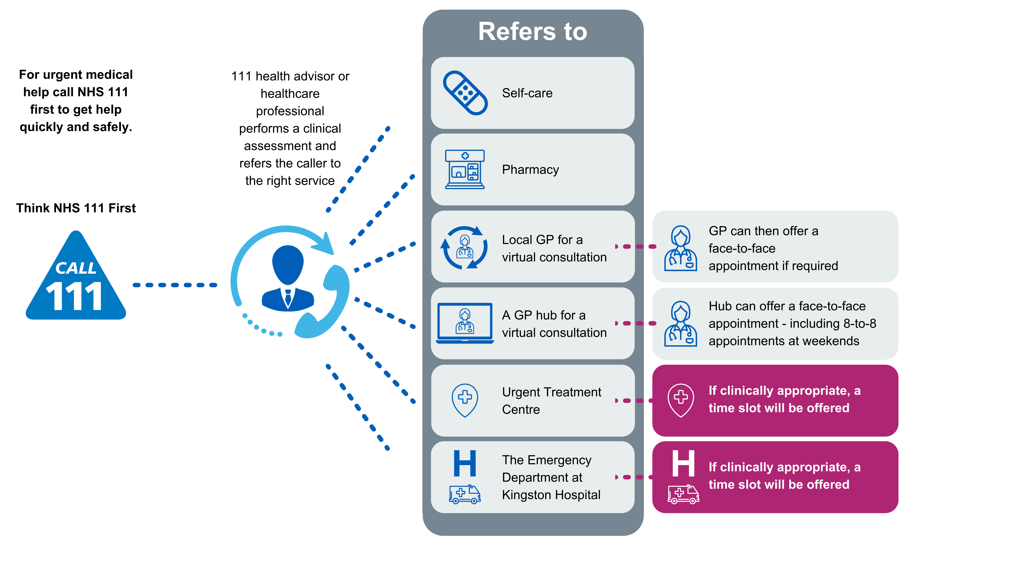
How it works
Notes:
The boxes on the bottom right in purple are what is new
Slots available 8am to 8pm.
At other times NHS 111 will ask you to go directly to A&E or UTC as normal.
The project is a locally lead partnership overseen by the local A&E delivery board which includes NHS providers, CCGs, local authority and NHS England.
*If not mentioned in previous slide*:
People can still go to ED and UTC as normal without phoning NHS 111 first.
However, as per above, Calling “NHS 111 First” will mean:
shorter waiting times
safe social distancing in hospital to protect you and others from COVID-19
This is particularly important for people with chaotic lifestyles – homeless, people with SMI, etc.

Slide 15
Proposed communications and engagement outline plan for ‘NHS 111 First’
Communication across Kingston, Richmond and East Elmbridge
Engagement with key audiences to refine communications
Support NHS England campaign across London
Key stakeholders/partners
Staff
Vulnerable adults
Parents of young children
Working age adults
Phase
Communication across Kingston Richmond and East Elmbridge (with refined content)
Phase
Stakeholders/partners
Staff
Wider community groups
Key audiences
Notes:
Working towards a start date of 31st October but will be a soft launch – will be running the system live to see that it works then assuming it does, will start promoting locally.
This is very much a draft outline comms plan and we still working on it with partners including HWK
The comms campaign will:
Promote NHS 111 as a first point of contact for urgent care, linked to safety around COVID and right place right time
Use data to focus targeted communications – including a digital campaign – at high intensity users – these are older people, carers, parents of young children, working age adults, students
Work through local partners – borough comms and engagement group – to ensure disadvantaged and vulnerable groups are communicated with effectively
Help us keep local A&E/UTC/GP practices safe and socially-distanced
Increase call volumes to 111 so that urgent care appointments are pre-booked where possible
Ensure staff/stakeholders understand the rationale for 111 First and can act as ambassadors
Ensure we are not asking people to stay away from A&E or GPs services
Ensure that people with serious or life-threatening illness or injuries should continue to dial 999
Working with local partners to develop this, including HWK and council

Slide 16
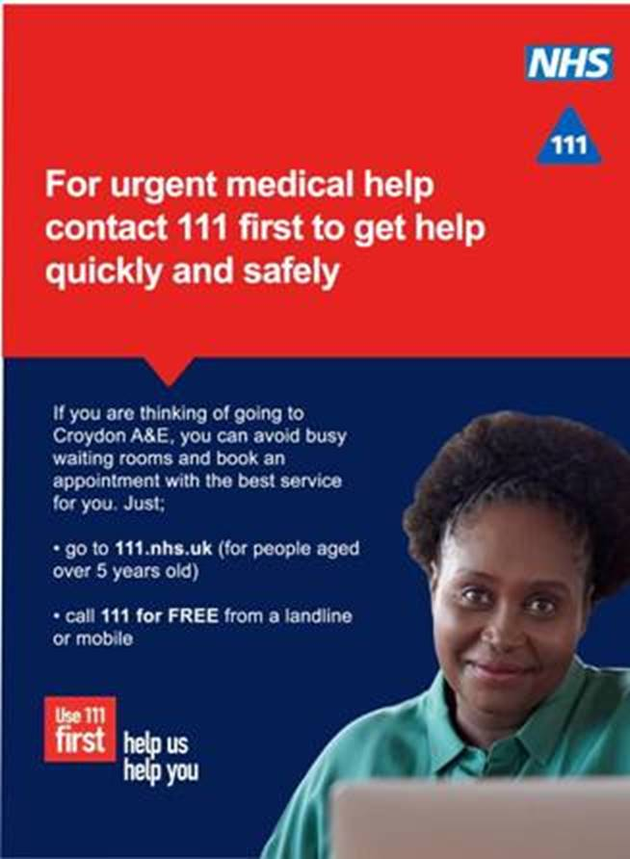
Products and toolkit
South West London CCG will provide a toolkit to support the campaign.
Please support the NHS by sharing and promoting the materials when you are sent them.
Notes:
Posters and leaflets for NHS premises
Website and newsletter text for partners
Screen savers/GP screens
Social media posts (funded) – targeted at areas of highest use and most deprivation
Media release
Letters to frequent A&E attenders
Films featuring local people
Standardised slides for engagement events
Translations of materials and easy read versions

Slide 17
The NHS is here for you
Please contact your GP as you usually would
If you’re worried about a health issue the NHS is here for you please come forward.
Most GP and outpatient appointments are now over the phone or video.
The NHS has plans in place to keep you safe if you do need to come in.
Notes:
Finally, we’d just like to remind everyone the NHS is still here for you, regardless of the pandemic. Would encourage people to…….
In particular: cancer, heart attack, stroke or mental health issues

Slide 18
Please spread the message
bit.ly/HereForYouKingston
bit.ly/HereforyouRichmond
Notes:
We’ve produced local videos – you can help us to spread the message by sending the link to your contacts which would be appreciated.

Slide 19
Draft high level timeline – Flu and NHS 111
Workstream | Key deliverable |  | Aug | Sept | Oct | Nov | Dec | Jan | Feb
Reassurance |  |  | ‘Keeping you safe’ reassurance films across all boroughs using paid media
Flu | Public priming campaign |  |  | Priming flu campaign
 | Primary eligible cohorts |  |  | Staff flu campaign | Behaviour change flu campaign hard launch |  | Second phase of behaviour change campaign
 | New eligible cohort |  |  |  |  | New 50-64 cohort
Pharmacy |  |  |  |  | Pharmacy campaign
UEC |  |  |  |  |  | Think NHS 111 First campaign (two phases)

