Slide 1
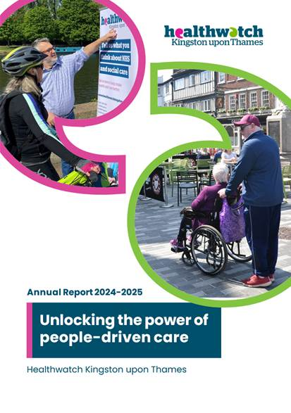
We're your local Healthwatch!
Come and tell us how we're doing
Public Meeting
Tuesday 7 October 2025, 12-2pm
Join the online Teams meeting
Meeting ID: 358 328 848 253 1
Passcode: 3bo7u59d

Slide 2

Healthwatch Kingston Public Meeting 7.10.25:

Slide 3
Healthwatch Kingston Public Meeting 7.10.25:
Agenda Part 1
12pm: Welcome & introductions – Candy Dunne, Deputy Chief Officer Healthwatch Kingston
12.15: Who we are and how we engage with you – Candy Dunne (DCO)
12.30: Tell us what you think about our engagement – Candy Dunne (DCO)
12.45: What do you think about our communications model - How else would you like to hear from us? – Candy Dunne (DCO)
1pm: 15 min comfort break

Slide 4

About Healthwatch Kingston
Healthwatch Kingston was set up by the Health and Social Care Act of 2012 to be the independent champion for local NHS and social care.
We seek the views of patients, service users, carers and the public to help services work better for the people who use them.
We play an important role bringing communities and services together.
Everything we say and do is informed by what local people tell us.
As well as encouraging those who run local services to act on what matters to people, we also share local views and experiences with Healthwatch England and the Care Quality Commission who make sure that the government put people at the heart of care nationally.

Slide 5
How do we engage with people
Community Events & Outreach: Conducted face-to-face “we’ll come to you” focus groups. Avoided assumptions about digital access or virtual engagement. Advocated for accessible venues and formats that meet the Accessible Information Standard.
Surveys & Listening Campaigns: We collect feedback from thousands of residents, including those from underrepresented groups.
Inclusive Practices: Delivered translated and accessible materials, including; Easy Read and Plain English versions, Audio formats and Podcasts, Translations (e.g., Traditional Chinese)
Digital Engagement: Our website and social media reach tens of thousands, offering information and signposting.
Enter & View Visits: Legally empowered visits to health and care services to observe and report on service quality.
Targeted Reports: Focused studies on topics like bereavement support, safeguarding, disability inclusion, and youth wellbeing.

Slide 6
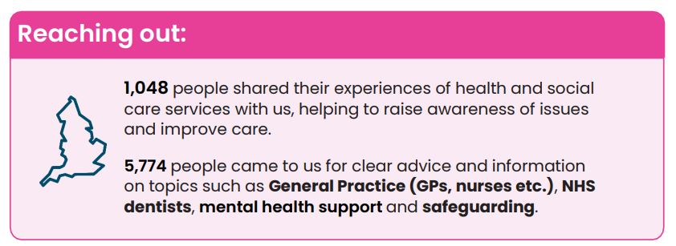
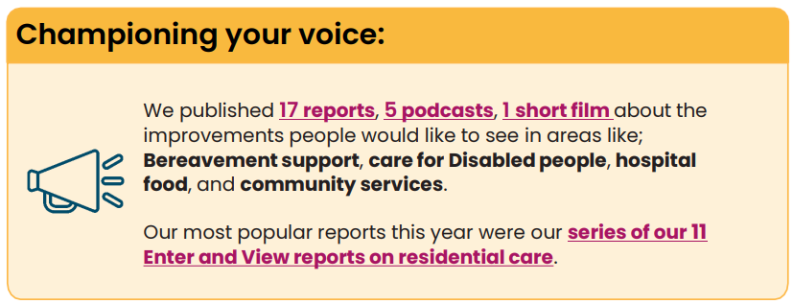
Engagement
We’ve engaged with more than 7,000 people to improve the quality of health and social care across Kingston. We currently employ 6 staff and our work is supported by 66 volunteers who contributed 2,058 hours to our work in 2024-2025.
HW Kingston Engagement Reports:
Including Communities: Engagement Report March 2022 to October 2023 | Healthwatch Kingston
Including Digitally Excluded Communities: Engagement Report | Healthwatch Kingston

Slide 7

HWK 5 Year Data Review
Since April 2025, Healthwatch Kingston have continued to reach out to every part of society, especially people in the most deprived areas, so that those in power hear their views and experiences.
We will continue to work together with partners and our local Integrated Care System to help develop an NHS culture where, at every level, staff strive to listen and learn from patients to make care better.
You can check out our planned seven key work areas for 2025-2026 in our Healthwatch Kingston Annual Report - Unlocking the power of people‑driven care but our main 3 work arears are outlined below:
Review Healthwatch Kingston community engagement data from the past 5-years to explore what insights and cross-cutting themes exist.
Convene a strategic review of youth engagement work in Kingston to explore collaborative initiatives.
Ensure required local Healthwatch functions transition smoothly during transformation.
As part of our literarily review and to inform the Carer Board, and subgroup (Carers Crisis Prevention Task and Finish Group), HWK have reviewed our most recent reports in 2024-25, for feedback and data from unpaid carers, and family and friend who play a caring role. The initial three reports and data sets we reviewed were:
Health and care needs of socially isolated, physically Disabled adults | Healthwatch Kingston
The health and care needs of under-5s and their families report | Healthwatch Kingston
South West London Bereavement Services and Support: Gaps Workshops Report | Healthwatch Kingston

Slide 8
Engagement Q&A
Q1. Have you engaged with HWK
Q2. Do you feel your feedback has made a difference? If not, what would help?
Q3. What’s the best way for us to share findings
Q4. What types of events or activities would encourage participation?

Slide 9
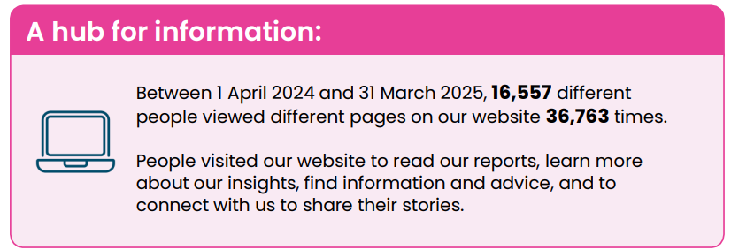
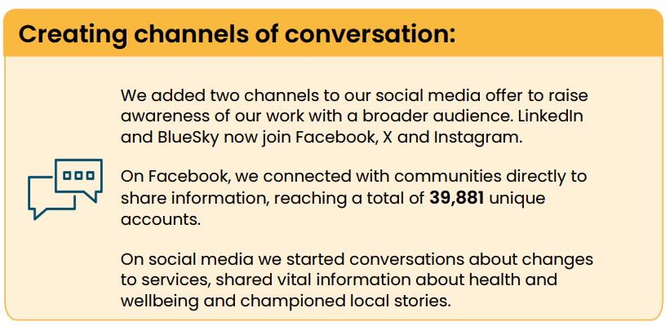
Our digital reach
Over the year, we have continued to expand and improve our digital information offer and expanded our presence across digital platforms to reach more people in Kingston.
Keeping local people in the loop:
We sent out 14 e-newsletters that were opened 6,108 times. Our newsletter allows us to connect with local people directly to ensure they are kept informed of service changes, get the opportunity to have their say, and understand the impact their experiences have.

Slide 10
Digital and Comms
Healthwatch Kingston provides information and updates through our website, e-newsletter and social media channels.
Q1: How do you prefer to hear from us?
Through social media
Through e-newsletters
Through direct emails
Through the website

Slide 11
Digital and Comms
Alongside insights from our project work, we promote information about local activities, groups and services as well as updates from the NHS.
Q2: What do you prefer to hear about from us?
Activities I can take part in
Groups I can join
Information about local services
Stories about people's experiences
News from the NHS
Something else

Slide 12
Digital and Comms
The Healthwatch Kingston website has a lot of information about local services, advice to help you get the most out of your care and insights from what local people have shared with us.
Q3: If you have used the Healthwatch Kingston website to find information, how easy did you find it to navigate?
Q4: What support would help you engage with us if you don’t use digital tools?

Slide 13

Healthwatch Kingston Public Meeting 7.10.25:
Comfort break
15 minutes.

Slide 14
Healthwatch Kingston Public Meeting 7.10.25:
Agenda Part 2
1.15: Project work – Have you been involved in any of our community projects? – Scott Bacon, Engagement Officer, Healthwatch Kingston
1.30: Enter and View – Does our model work for you? – Jill Prawer, Project Officer, Enter and View, Healthwatch Kingston
1.45: Open discussion – anything else to say to us about how we work? – Candy Dunne (DCO)
2pm: Meeting close

Slide 15
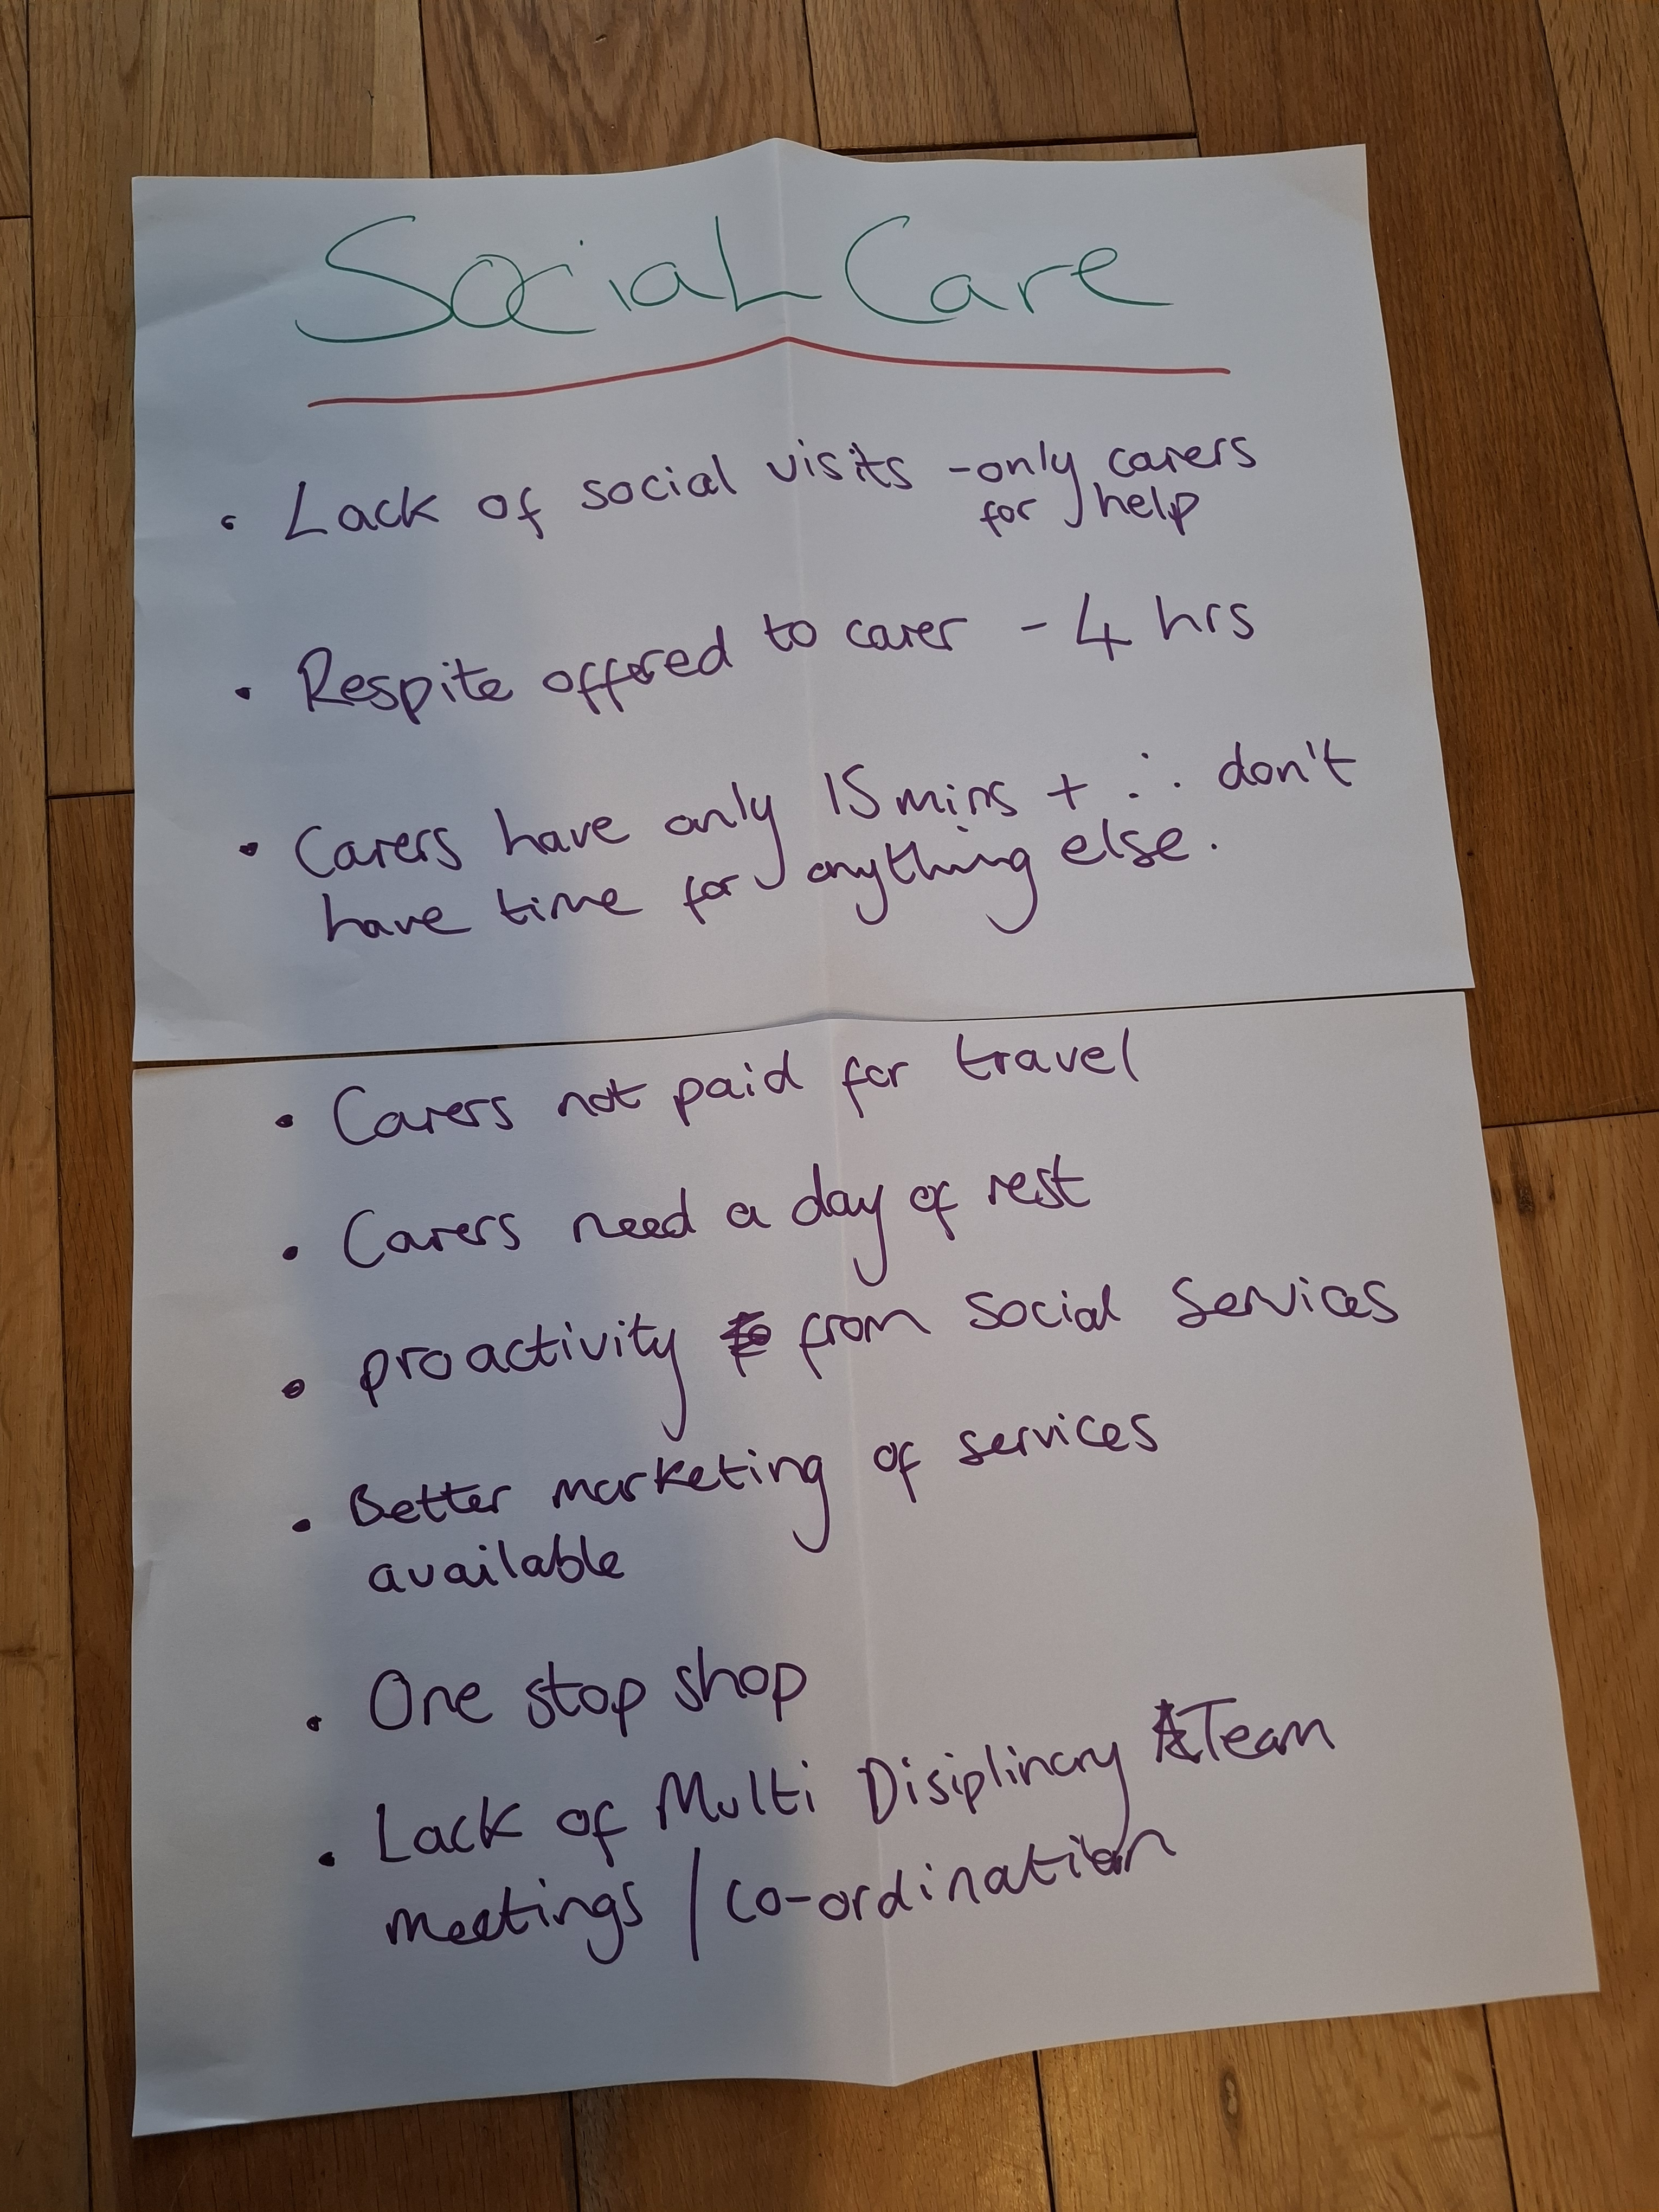
Project work – Have you been involved in any of our community projects? Scott Bacon, Engagement Officer, Healthwatch Kingston
Care workforce wellbeing project
Making Safeguarding Personal
Kingston Safeguarding Voices
A Virtual conversation on Virtual Wards
All Ages Learning Disability Partnership Board
Including Digitally Excluded Communities
Including Communities
London Ambulance Service
Youth Out Loud! - access to NHS services for young people with a Disability
Youth Out Loud! - grief and bereavement film
Youth Out Loud! - pages for young people
Health and care needs of 0-5s
Health and care needs of socially Isolated and physically Disabled adults

Slide 16
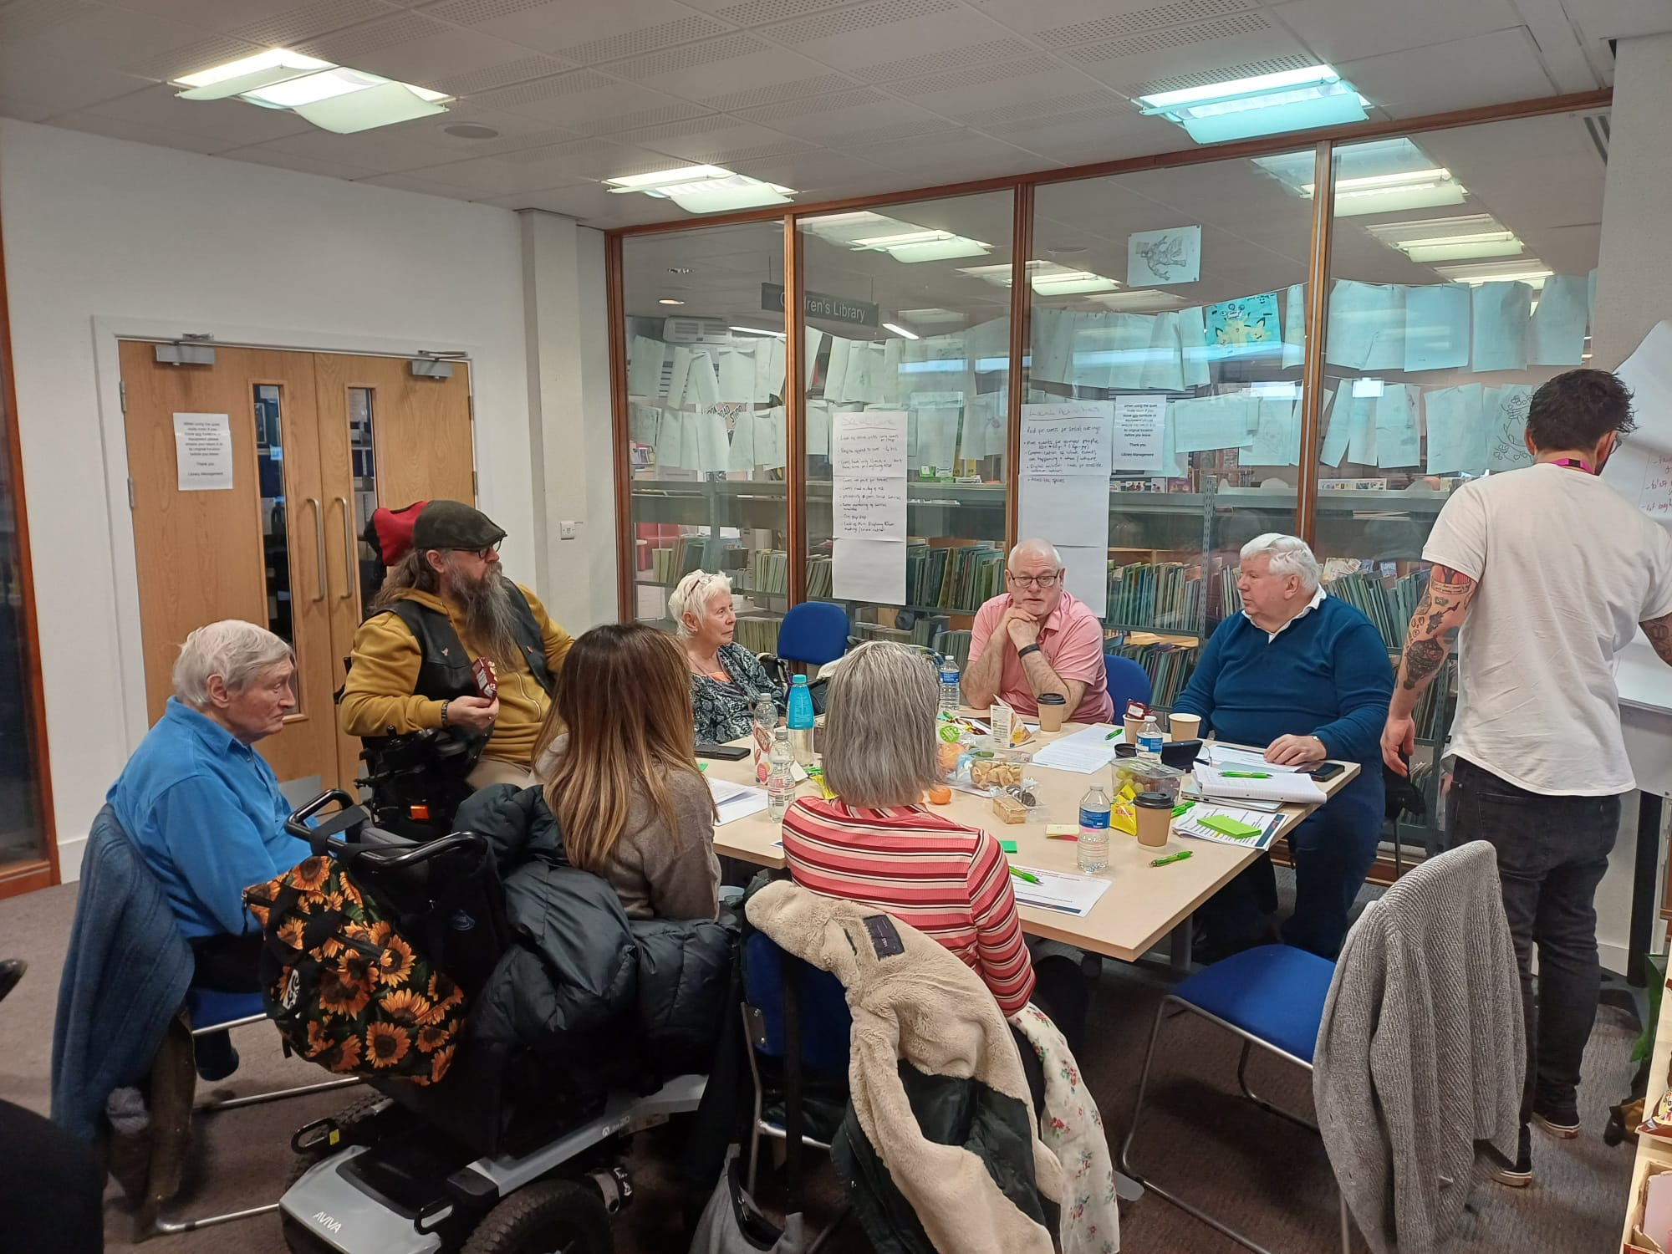
Project work – Have you been involved in any of our community projects? Scott Bacon, Engagement Officer, Healthwatch Kingston
Q. What worked well and what could be better?
Q. What barriers have you faced when trying to share
your views with us?
Q. Are there groups or communities in Kingston you
feel are not being heard?
Q. Are there groups or communities in Kingston you feel are not being heard?

Slide 17

Enter and View – Does our model work for you?
Legislative framework for Healthwatch is divided between what Healthwatch must do (duties) and what they may do (powers). Healthwatch have a power under the Local Government and Public Involvement in Health Act 2007 and Part 4 of the Local Authorities Regulations 2013 to carry out Enter and View visits.
The purpose of an Enter and View visit is to collect evidence of what works well, and how the service could be improved to make people’s experiences better. Healthwatch can use this evidence to make recommendations and inform changes both for individual services as well as system wide.
In March 2024 Kingston Council commissioned HWK to run a series of announced HWK Enter and View visits to local care and nursing homes between April 2024 and March 2025 to support a wider understanding of care provision and the wellbeing of residents using these services in the borough
Funding has been continued for the year 2025/26 to include visits to supported living provisions across the borough.

Slide 18

HWK Enter and View Focus
As KCGB already has oversight regarding risk management, safeguarding, performance monitoring, and quality management, the HWK Board made the decision to focus the enter and view visits on the following three areas.
living environment.
mealtime experiences; and
meaningful activities within the care setting.
The visits give residents the opportunity to share their lived experience of being in a care provision, and for the HWK visiting team to observe mealtimes and activities, as well as speak to staff members, and relatives of the residents, about their impressions and experiences. Healthwatch Kingston also provides independent insight.

Slide 19
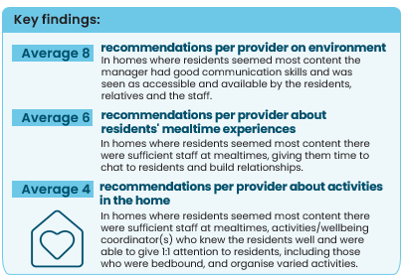
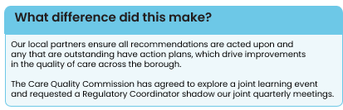
Healthwatch Kingston annual report 2024-2025:
Improving the quality of life for care home residents
Highlights from the Healthwatch Kingston annual report 2024-2025
Across 10 months, we completed 14 Enter and View visits to 10 residential care providers. We spoke to 119 people about their experiences and collaborated with local partners to ensure the quality of the residents' care. We observed the living environment, mealtime experiences and activities provided to give feedback that improved local peoples' quality of life

Slide 20

HWK – Enter and Views 2024/25
In March 2024 HWK undertook an announced Enter and View to Rosclare Residential Home, the report was published in July 2024 on the HWK website and included provider responses to the recommendations.
April 24 - March 25, HWK completed E&Vs at ten care and nursing homes in Kingston, over 14 visits:
Amy Woodgate House x 3 visits in June (Capacity 44) Report
Langley Court Rest Home x 1 visit in July (Capacity 28) Report
Cloyda Care Home x 1 visit in July (Capacity 35) Report
Brook House Nursing Home x 1 visit August (Capacity 32) Report
Sherwood Grange Care Home x 3 visits in September(Capacity 59) Report
Milverton Nursing Home x 1 visit in October(Capacity 30) Report
Surbiton Care Home x 1 visit in November (Capacity 26) Report
Kingston Neurorehabilitation Centre x 1 visit in December (capacity 36) Report
Speirs House Care Home x 1 visit in January (capacity 36) Report
Medihands Clifton x 1 visit in February (capacity 12) Report
All reports can be found using this link Home | Healthwatch Kingston

Slide 21

Healthwatch Kingston Public Meeting 7.10.25:
From all of us at

Slide 22

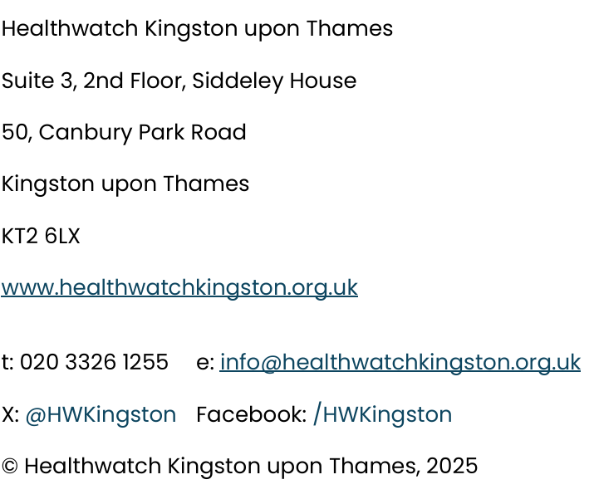
Contact Healthwatch Kingston:

