Slide 1


Healthwatch Kingston Festive Celebration
Public Meeting
Tuesday 9 December 2025, 12-3.30pm

Slide 2
Healthwatch Kingston Public Meeting 9.12.25:
Agenda Part 1
12.30: Festive lunch and networking
1.00: Welcome Stephen Bitti (Chief Officer - Healthwatch Kingston) and David Bennett (Vice chair of All Ages Learning Disability Partnership Board)
1.00: All Age Learning Disability Strategy priority refresh– Stephen Bird and Surinder Jassal (Kingston Council)
1.30: Winter mental health and wellbeing support – Liz Trayhorn (Public Health)
2.00: 15 min comfort break

Slide 3
Healthwatch Kingston Public Meeting 9.12.25:
Agenda Part 2
2.15: Update on Healthwatch Kingston recent projects – Stephen Bitti (Chief Officer Healthwatch Kingston)
2.45 Update from Youth Out Loud! – Scott Bacon (Healthwatch Kingston/YOL!) and YOL! members
3.15: Thank yous and goodbyes

Slide 4

Royal Borough of Kingston - LD Partnership Board Dec 2025
Priority Refresh
Stephen Bird (RBK Strategic Commissioning)

Slide 5
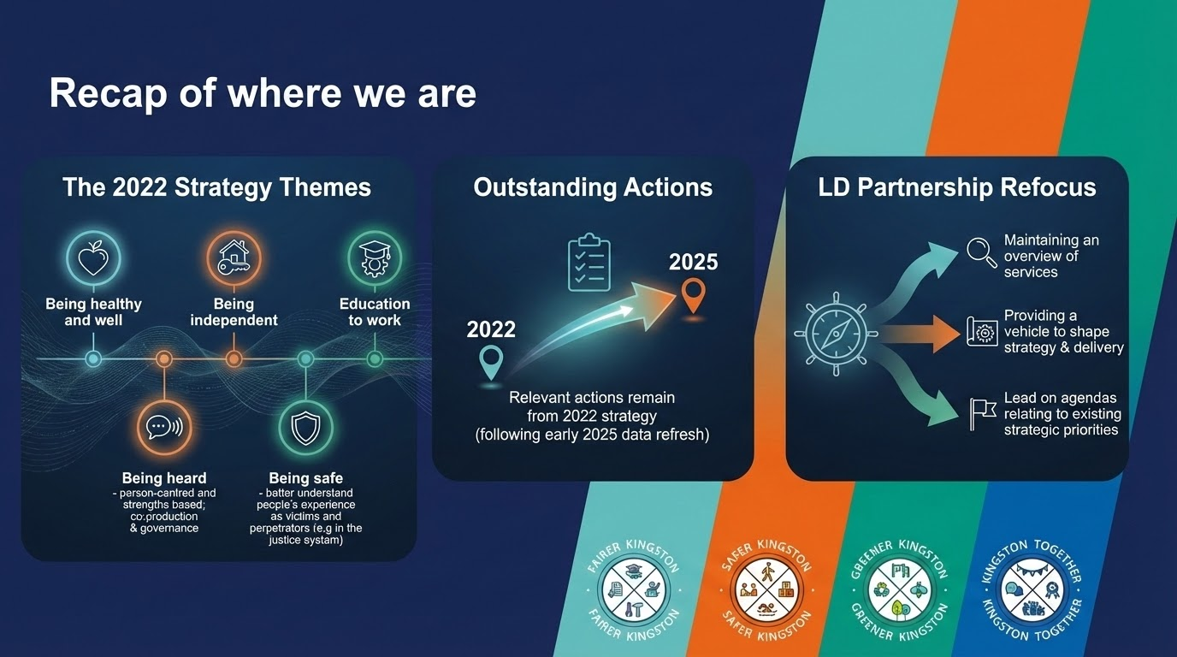

Slide 6
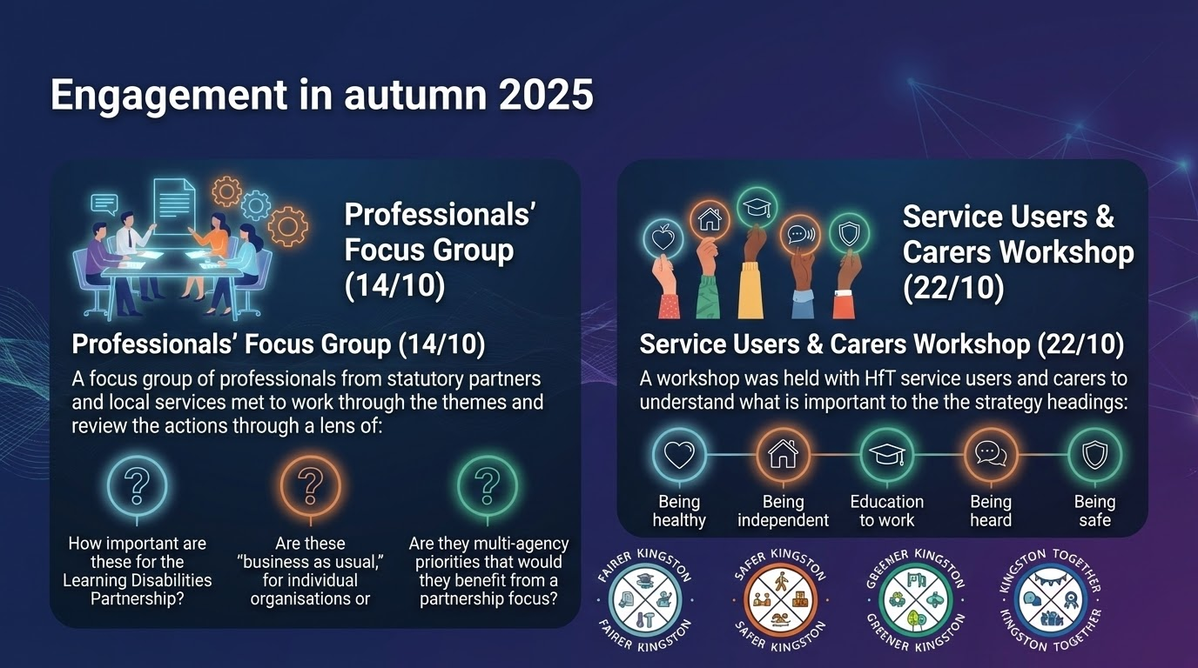

Slide 7
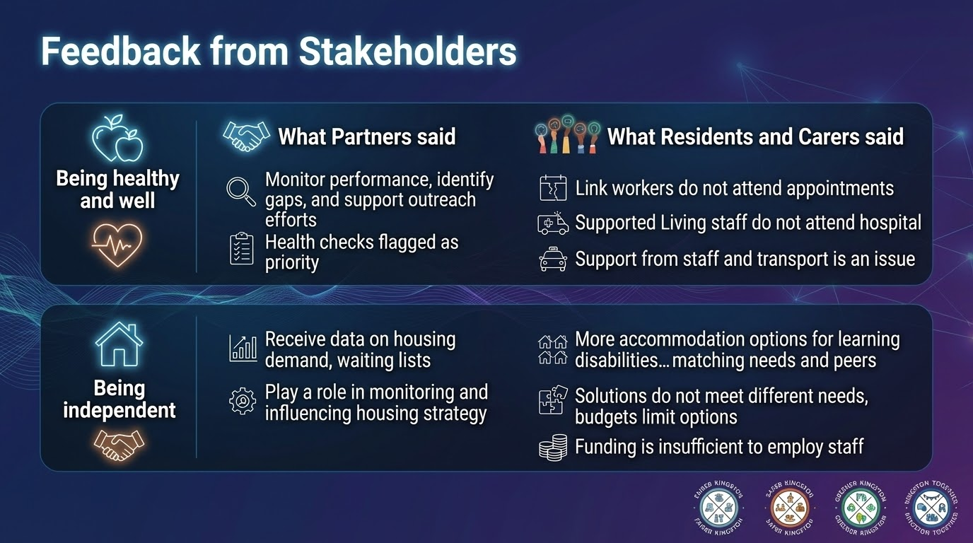

Slide 8
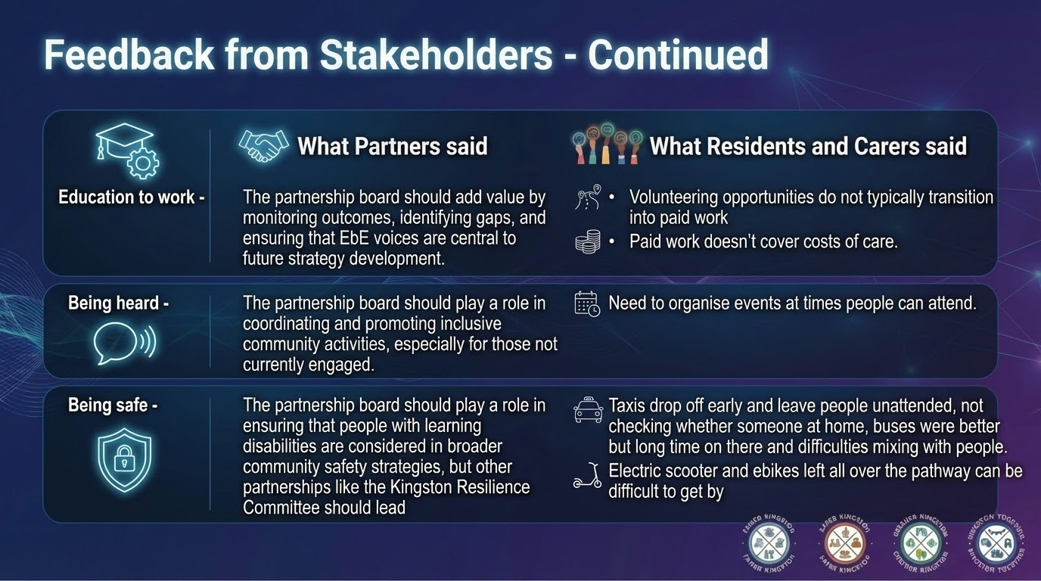

Slide 9
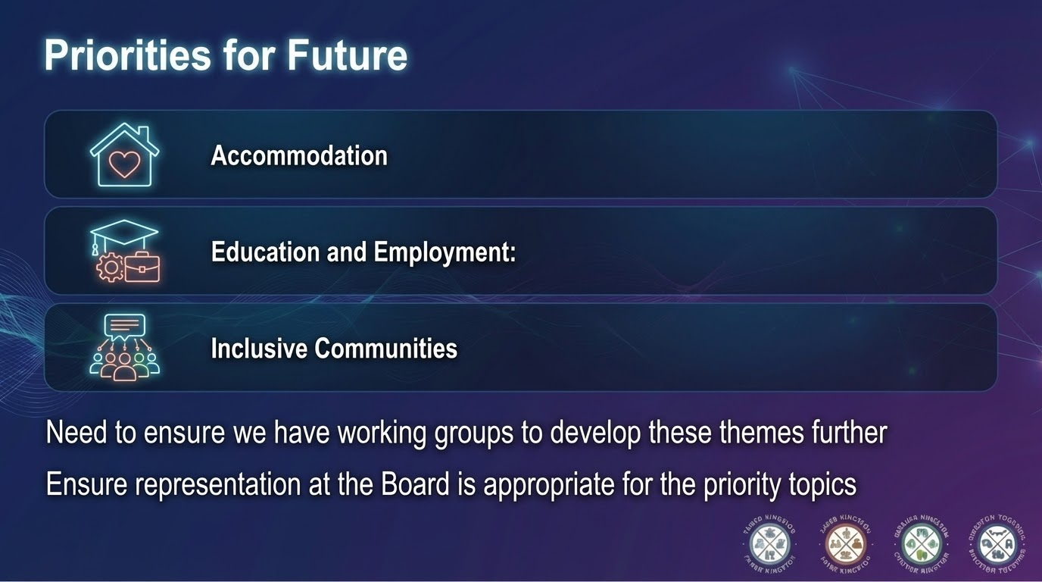

Slide 10
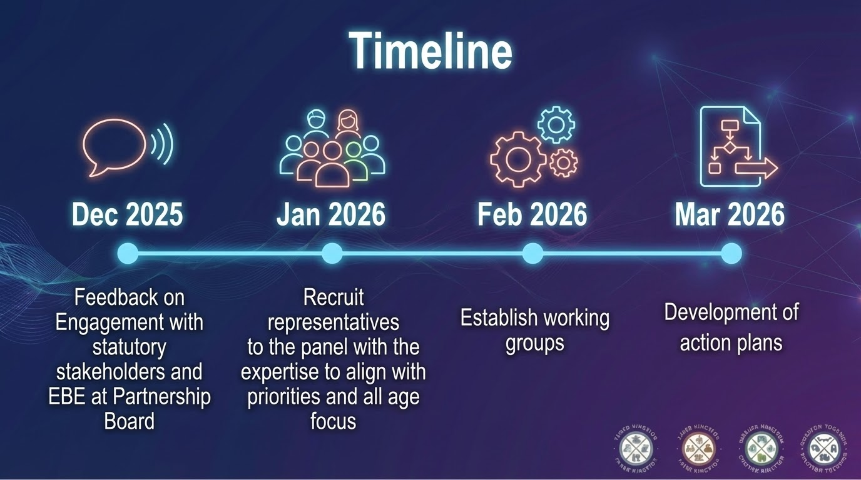

Slide 11



Dates of next All Age Learning Disability Partnership Board meetings
Date | Time | Location
Tuesday 24th February 2026 | 10.30am- 12.30pm | Online
Wednesday 22nd April 2026 | 10.30am- 12.30pm | Online
Thursday 25th June 2026 | TBC | TBC

Slide 12

Winter mental health and wellbeing support in Kingston
Liz Trayhorn

Slide 13
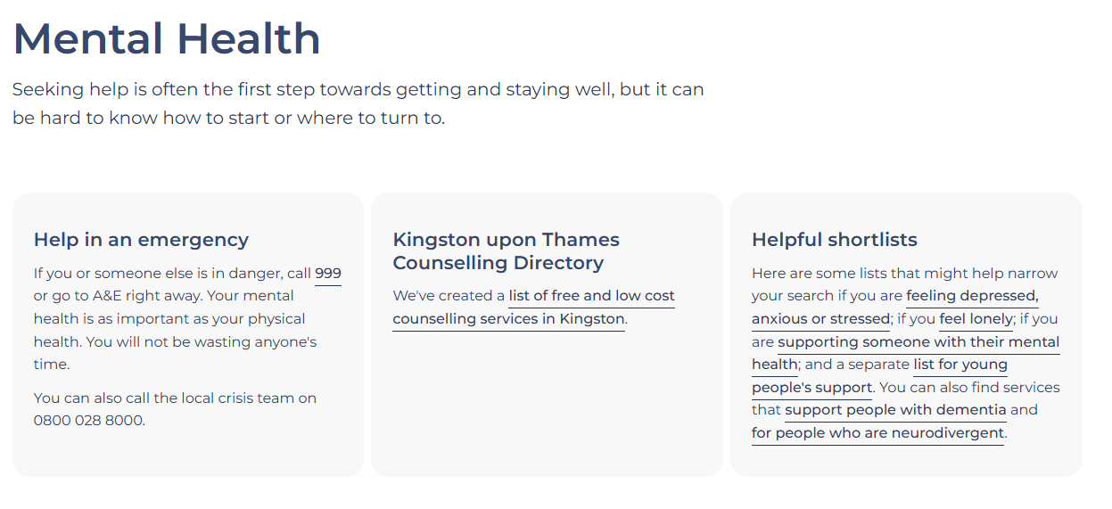
Connected Kingston mental health
https://connectedkingston.uk/categories/mental-health

Slide 14
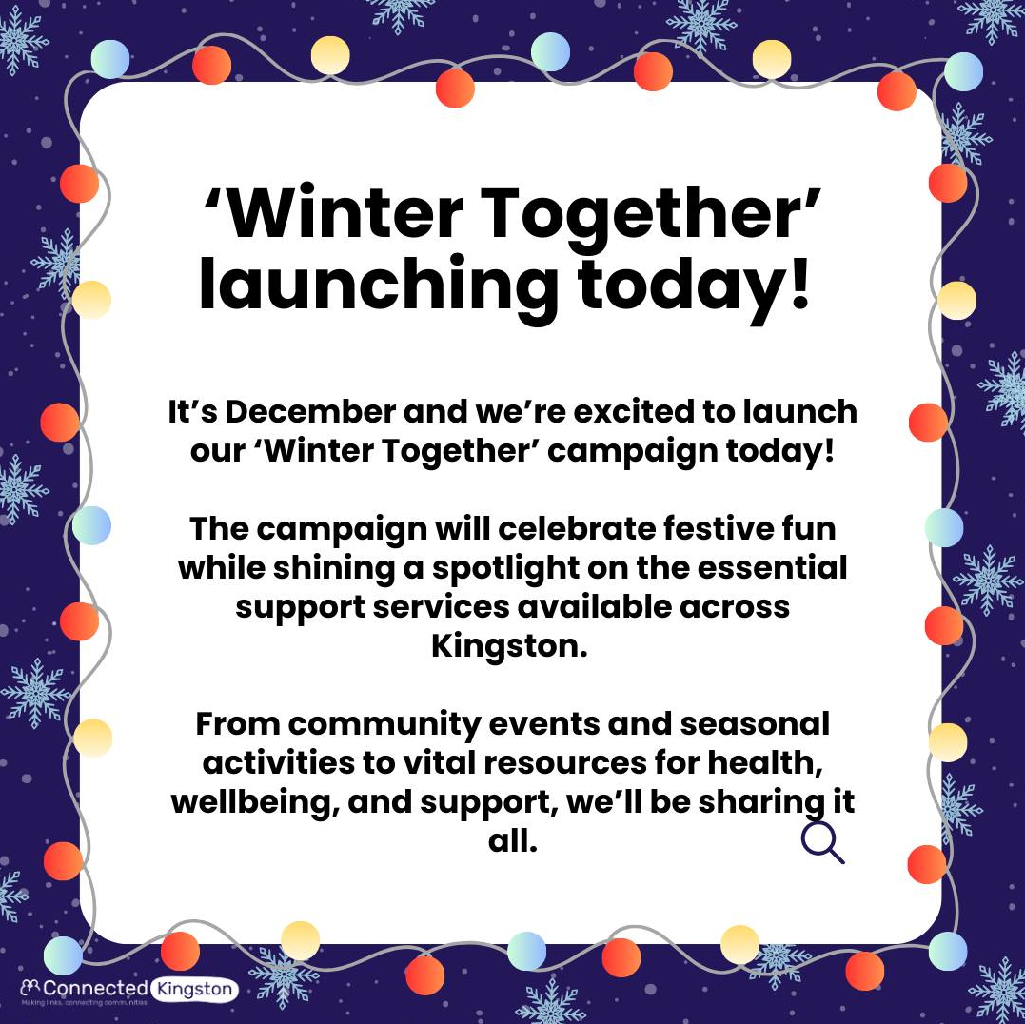

Connected Kingston ‘Winter Together’
Festive activities and support services available over winter.
Please promote: https://connectedkingston.uk/events
We are keen to include as many free, local activities as possible, so please do add your events onto Connected Kingston or contact admin@kva.org.uk

Slide 15
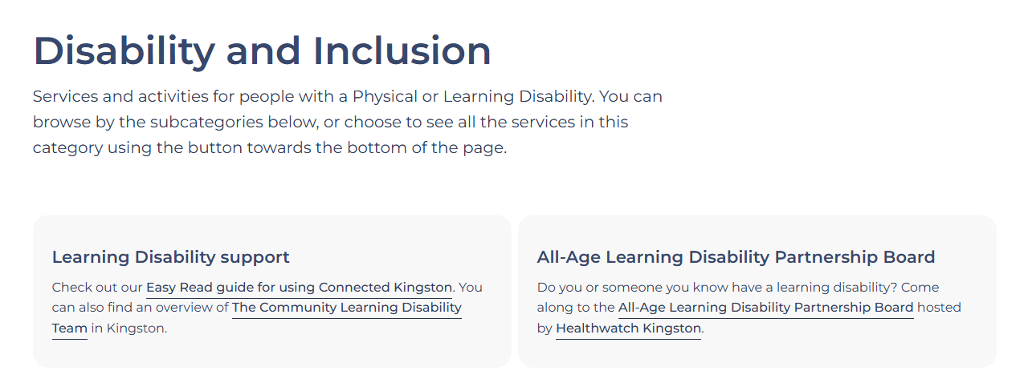
Connected Kingston collections
https://connectedkingston.uk/categories/disability-and-inclusion

Slide 16
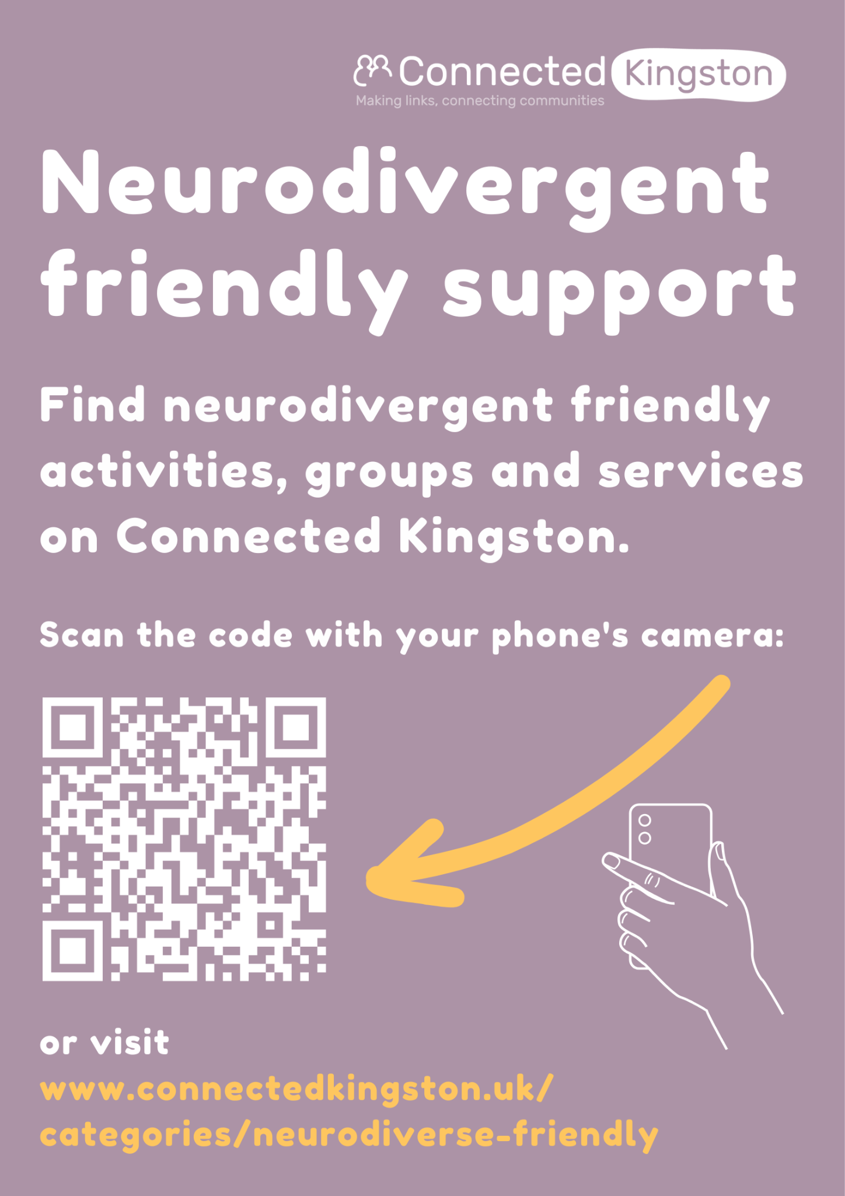
Neurodiversity Collection
This collection brings together 15-20 essential services, groups and organisations that someone who is Neurodivergent might like to know about.

Slide 17
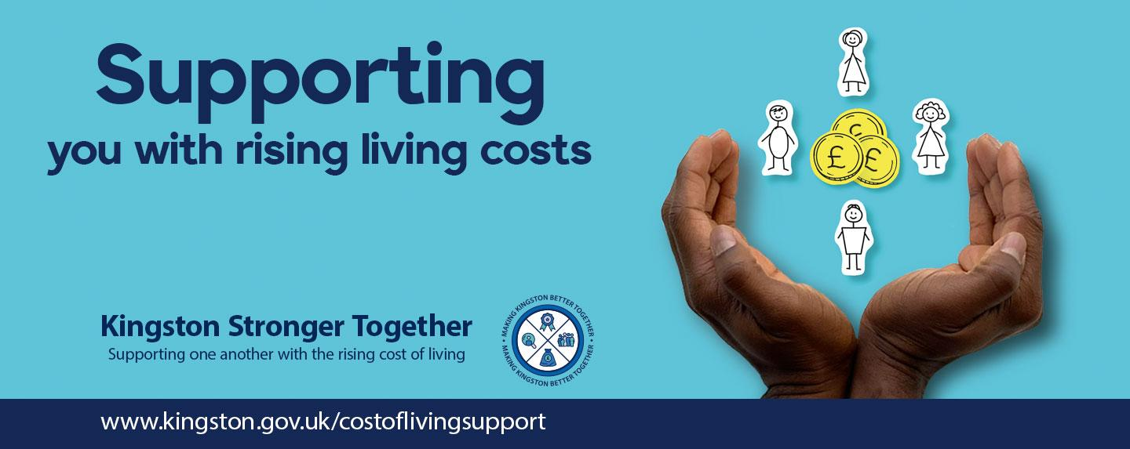
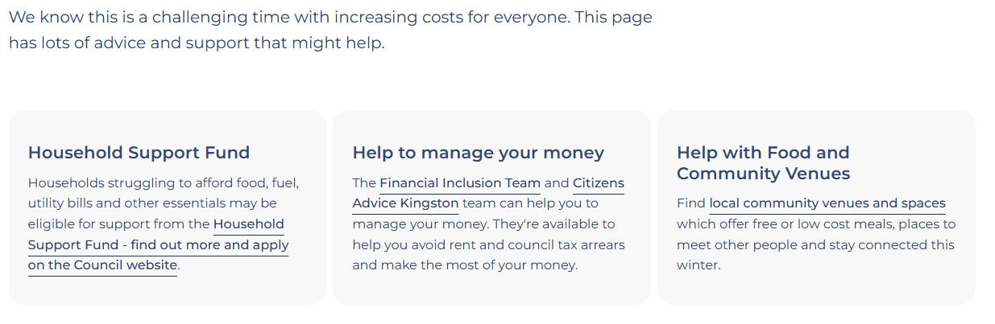
Cost of living Support
https://connectedkingston.uk/categories/cost-of-living-support

Slide 18
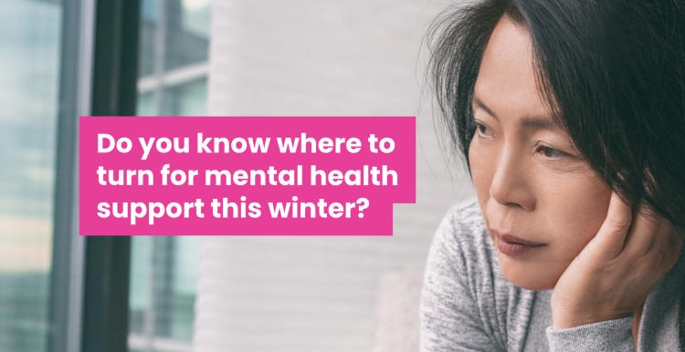
Mental Health Support
Healthwatch Kingston’s fantastic blog, summarising where to go for help
Get urgent help
If you or someone else is in danger, or you cannot keep yourself or someone else safe call 999 or go to a hospital now.
If you need urgent help with your mental health, you can call:
0800 028 8000 to speak to Kingston’s NHS mental health crisis line
111 and select the mental health option

Slide 19
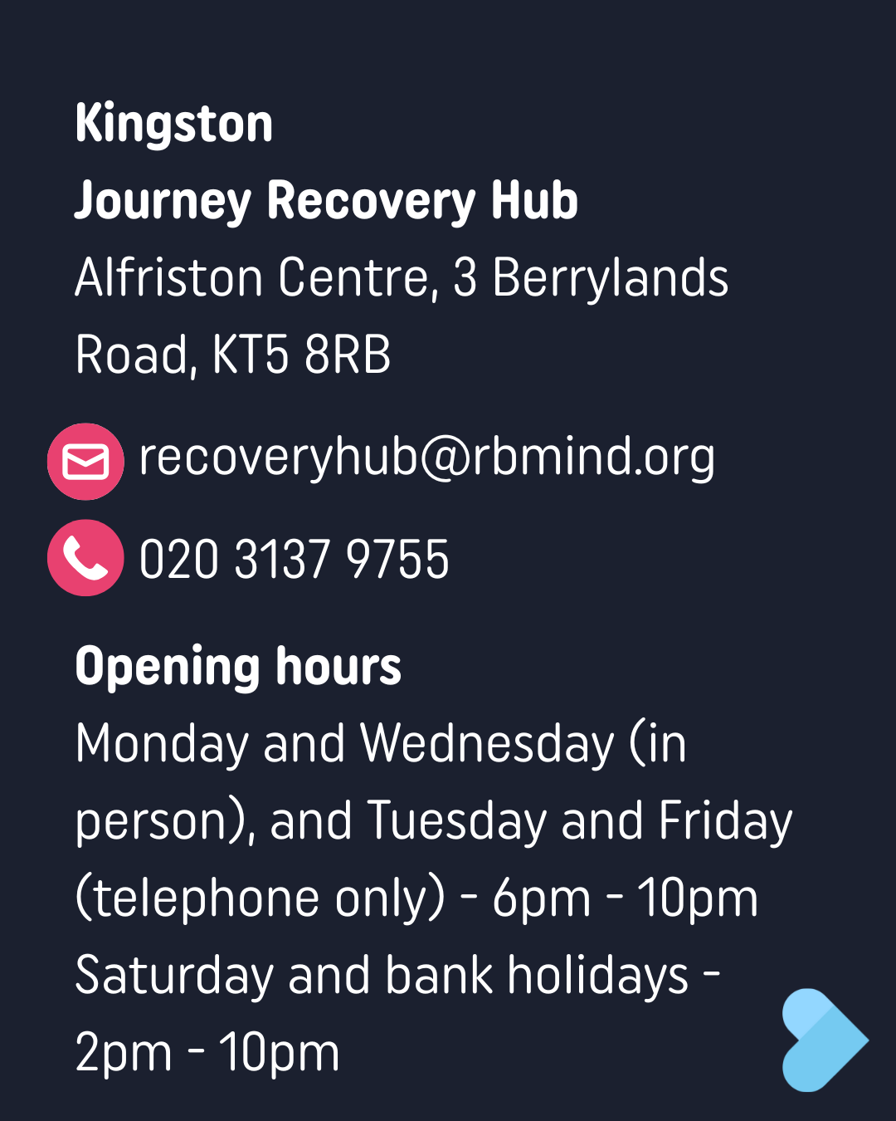
Crisis line videos
SLP Crisis Line - Kirt - Portrait Video.mp4
South West London Mental Health Crisis Line - Peju - Landscape Video.mp4

Slide 20
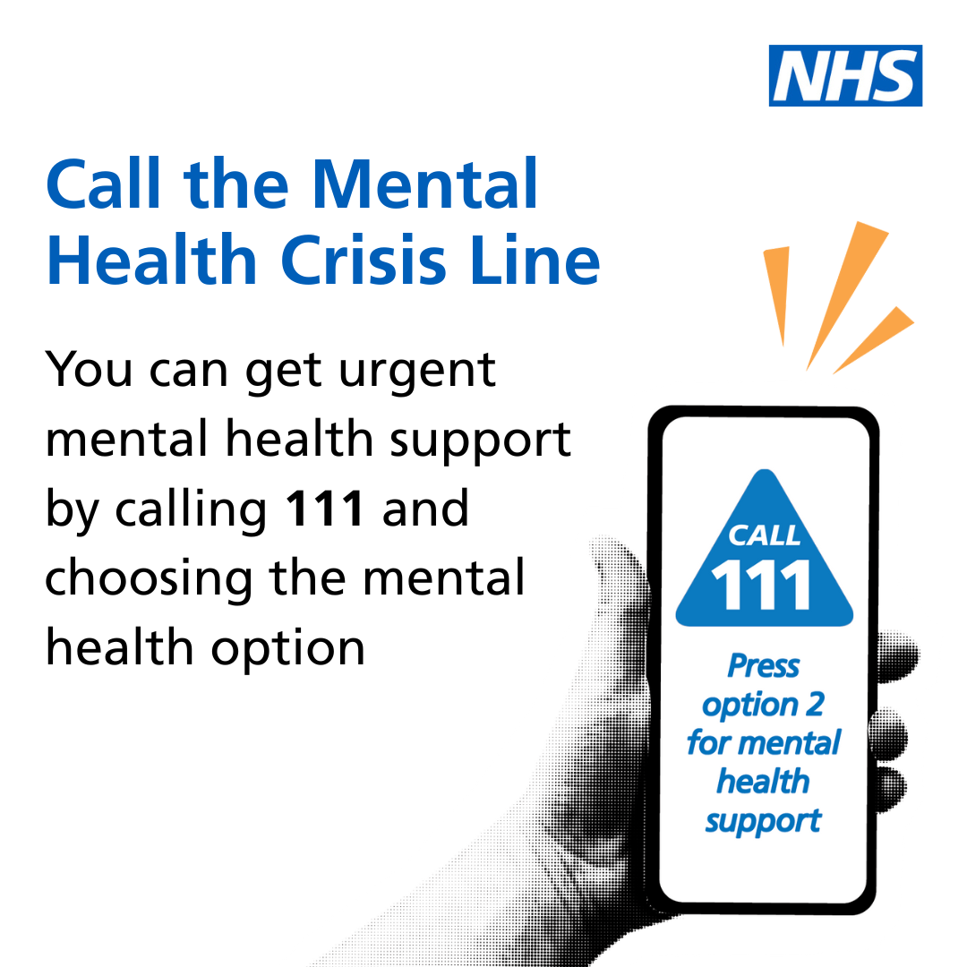

Slide 21
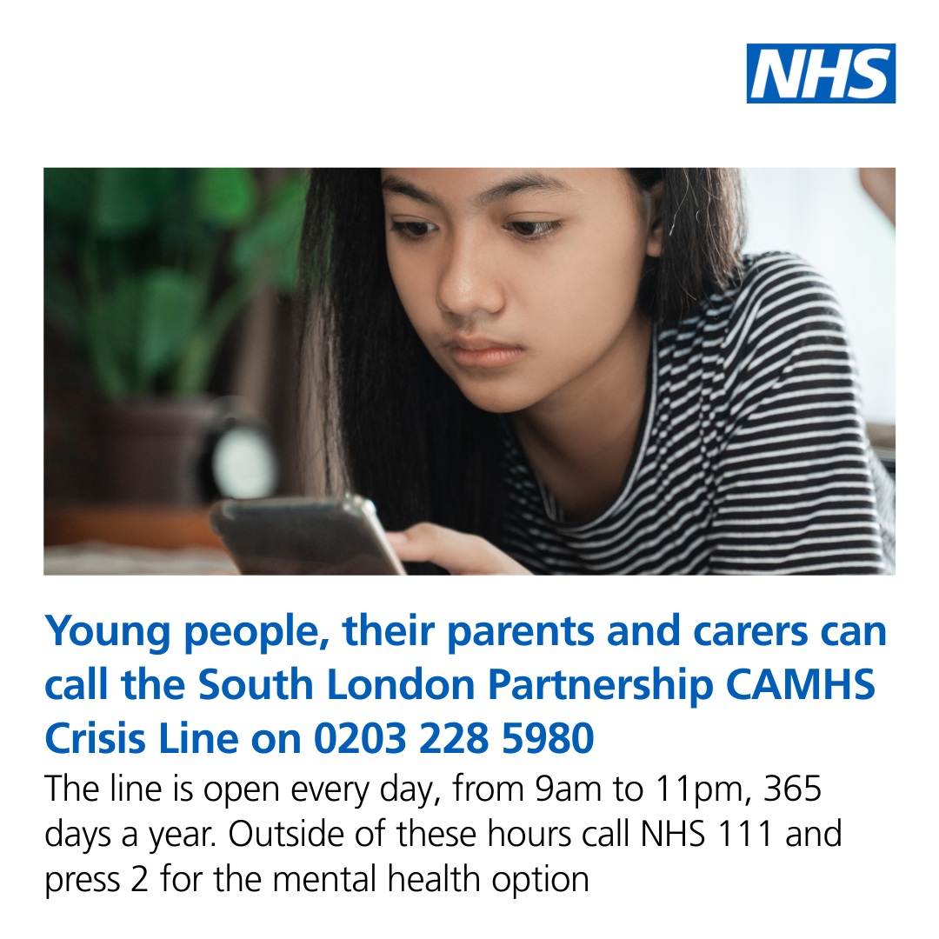
Children's mental health
Christmas 2025.mp4

Slide 22
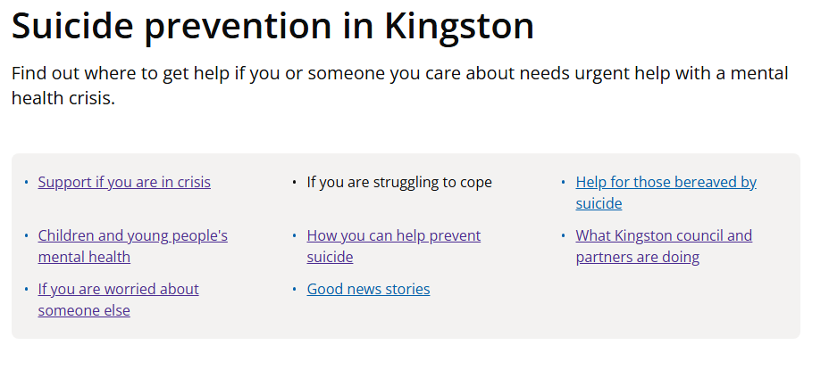
Suicide prevention
https://www.kingston.gov.uk/health-and-wellbeing/mental-health/suicide-prevention-kingston/if-you-are-struggling-cope

Slide 23
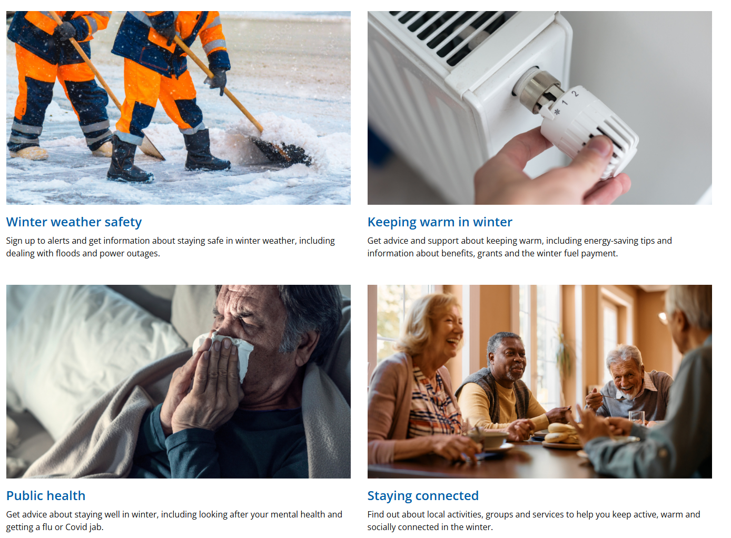
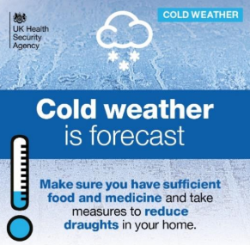
Staying safe and well in winter
https://www.kingston.gov.uk/winter-advice

Slide 24
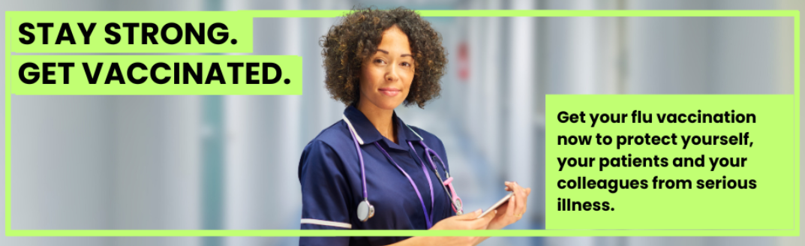
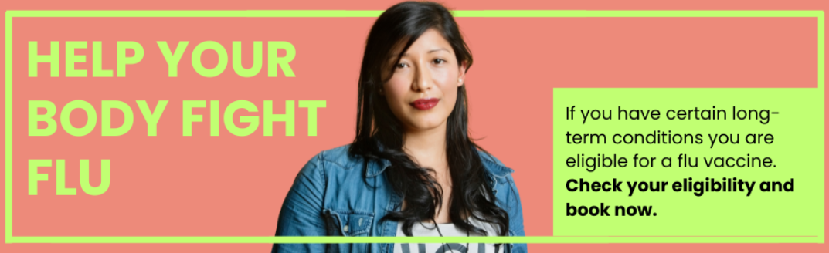

Vaccination comms for Winter 2025/26
Flu activity is increasing with an unusually early start of the influenza season
One of the ways people can protect themselves over winter is to get vaccinated against flu and COVID-19 if they are eligible. See: Winter vaccinations and winter health - NHS

Slide 25

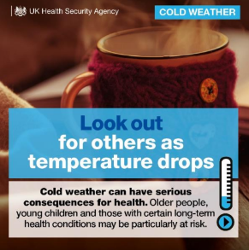
Cold weather messages
Here are ways people can keep themselves and others safe during periods of cold:
Check on family, friends and neighbours who may be at higher risk of becoming unwell, and if you are at higher risk, ask them to do the same for you
Check the weather forecast and the news
Make sure you have sufficient food and medicine
Take simple measures to reduce draughts at home
Heat rooms you spend most time in, to 18 ̊C if you can
Keep bedroom windows closed at night
Wear multiple layers of thinner clothing

Slide 26

Healthwatch Kingston Public Meeting 9.12.25:
Comfort break
15 minutes.

Slide 27
Healthwatch Kingston Public Meeting 9.12.25:
Agenda Part 2 - reminder
2.15: Update on Healthwatch Kingston’s recent projects – Stephen Bitti (Chief Officer Healthwatch Kingston)
2.45 Update from Youth Out Loud! – Scott Bacon (Healthwatch Kingston/YOL!) and YOL! members
3.15: Thank yous and goodbyes

Slide 28
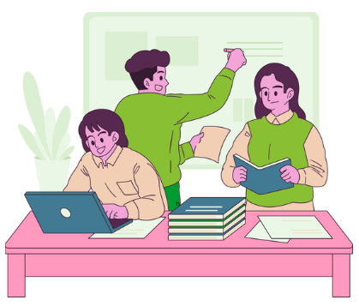
Healthwatch Kingston’s Recent Projects
Stephen Bitti – Chief Officer Healthwatch Kingston

Slide 29

Healthwatch Kingston public meeting. 09.12.2025
Interviews for accessing services.
Health messaging results.
Smoking/vaping page.
What is next.

Slide 30

Care access issues for young Disabled people
Surveys
Outreach in a school and college
Interviews
Podcast
Published on yolweb

Slide 31
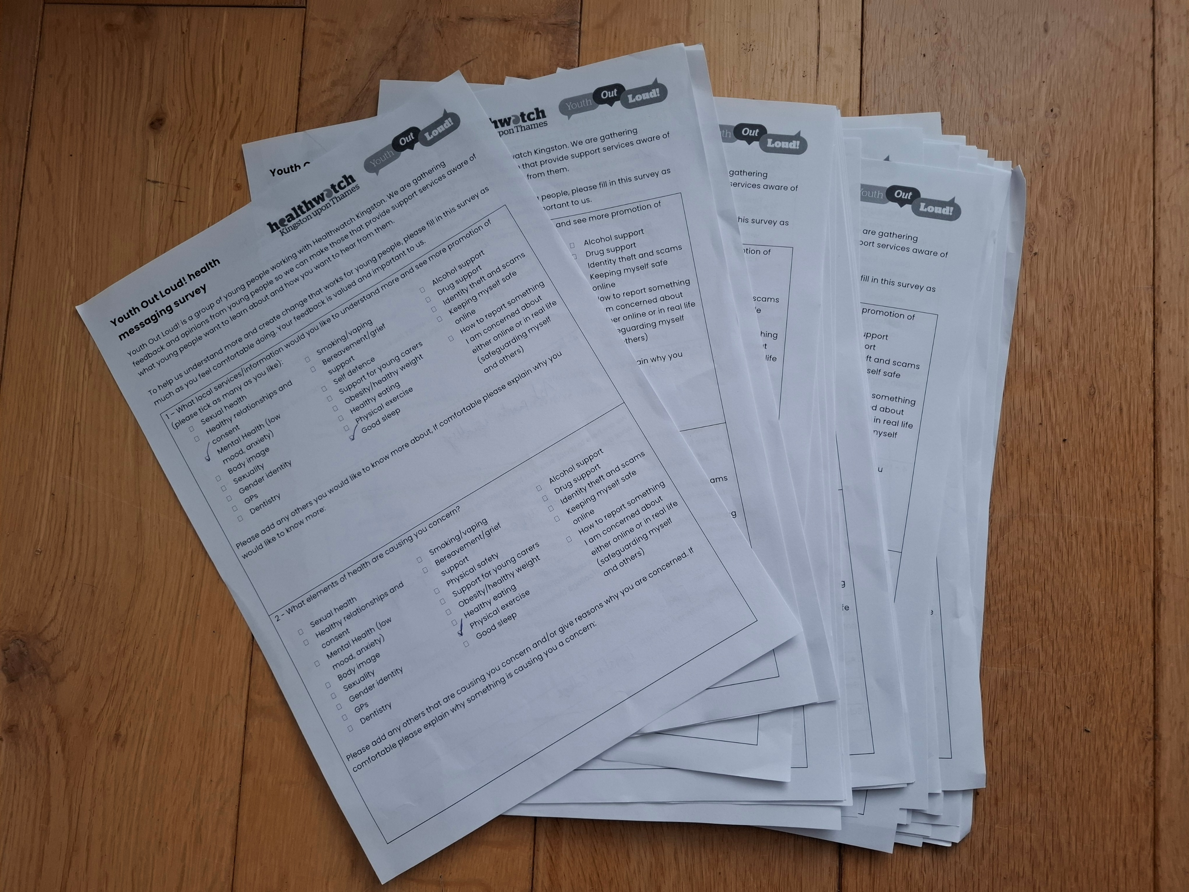
Health messaging
At YOL! we asked what health messaging do young people want to know about
For example, one question was ‘what is concerning you about your health?’
This information will help professionals delivering services to young people understand what young people would like to know about and how they want information

Slide 32

Any questions?

Slide 33
Health messaging

Slide 34
Health messaging

Slide 35
Health messaging

Slide 36
Health messaging

Slide 37
Health messaging

Slide 38
Health messaging

Slide 39
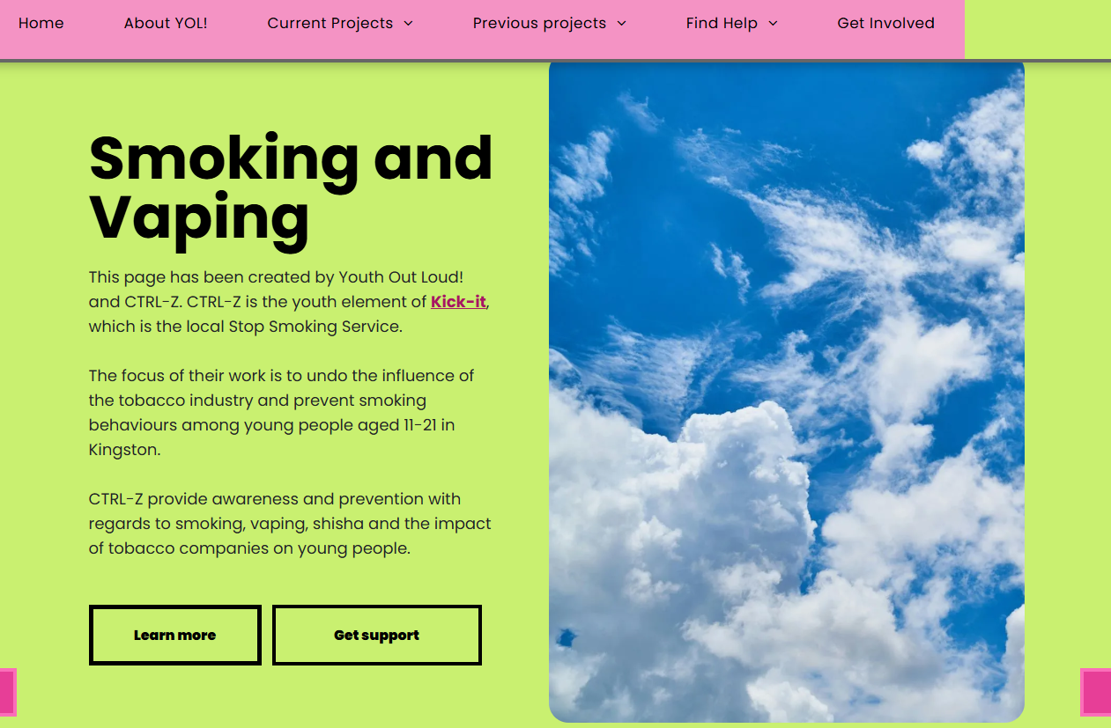
Smoking and vaping page on yolweb
Meeting with Ctrl-Z who are local providers for stopping smoking and vaping
Create the page with information from the meeting with Ctrl-Z.
Promotion of the page through schools and youth groups

Slide 40
What is next
One film is on bereavement and grief from the perspective of young people with a learning Disability.
A second film on menstrual health. Helping young women understand what is healthy, what pain needs help.
Continuing to signpost on social media
Create new pages on yolweb with information for young people created by young people with health and care professionals.

Slide 41
Any questions?

Slide 42

Next Healthwatch Kingston public meeting
Tuesday 28th April 2026
12pm – 3pm
Online via MS teams

Slide 43



Thank you
From all of us at

Slide 44

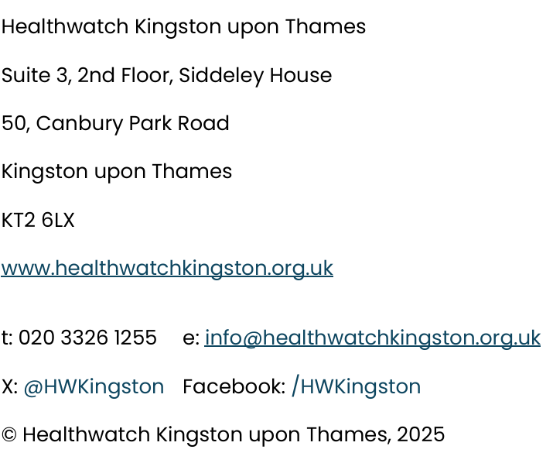
Contact Healthwatch Kingston:

