Slide 1
The Covid-19 Outbreak
Kingston Hospital Update
Sally Brittain, Director of Nursing & Quality & Director of Infection Prevention & Control
Sarah Shade, Head of Nursing for Planned Care

Slide 2
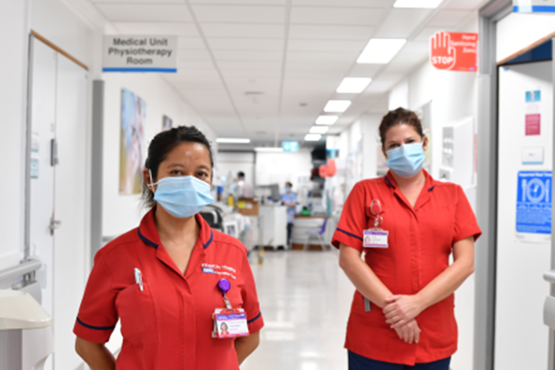
Current position
The emergency department
Inpatients
Outpatients
Maternity services
Cancer services

Slide 3
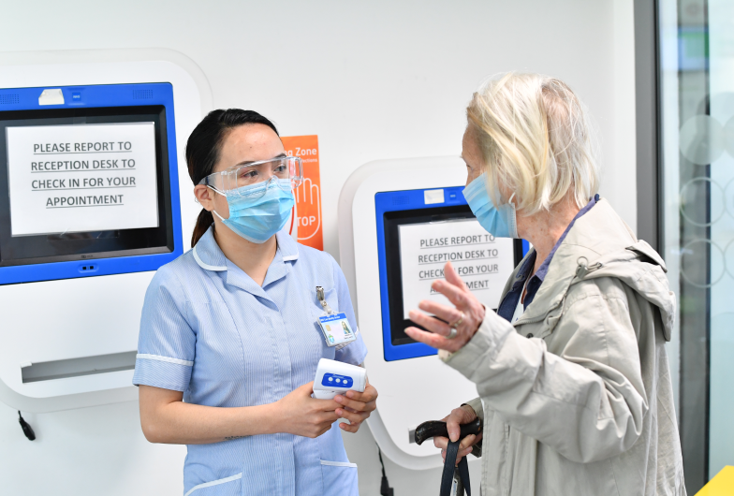
Infection prevention and control
What we ask of our patients and their loved ones
What we ask of our staff
How we are working within the south west London health and care system

Slide 4
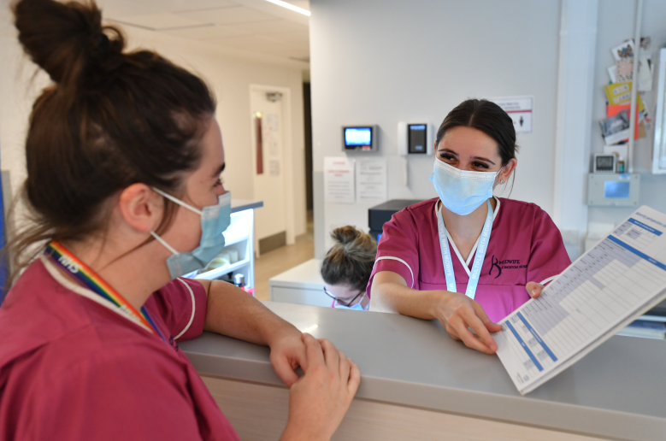
Staff health and wellbeing
Safe staffing
Emotional support
The environment
What you can do to help us

