Slide 1
Healthwatch Kingston Open Meeting
Social Care
Tuesday 7 November 2023

Slide 2
HWK Open Meeting Agenda –
Tuesday 7 November - 12pm.
Agenda
12.00 – Welcome and introductions – Stephen Bitti, CEO Healthwatch Kingston
12.15 – Update on RBK Adult Social Care developments and Q&A – Sam Morrison, RBK Interim Director of Adult Social Care
13.00 – Cost of Living Crisis and Q&A – Emma Crowe, RBK Communications Lead
13.30 – Lunch break
14.00 - Update on work of Kingston Safeguarding Adults Board and Q&A – Nicola Brownjohn, Chair, Kingston Safeguarding Adults Board
14.45 – Wrap up – Stephen Bitti
15.00 – Close

Slide 3
Update on RBK Adult Social Care developments and Q&A
Sam Morrison
RBK Interim Director of Adult Social Care

Slide 4
Healthwatch Kingston
RBK - Adult Social Care & Commissioning update
Sam Morrison - Acting Director of ASC

Slide 5
ASC Developments
National and local context for ASC
RBK updates
Council Plan - Greener, Fairer, Safer and Together
Demand challenges
Housing
Vision
CQC Assurance Framework
Working together

Slide 7
Our changing world - Kingston
Money
Complexity & Demand
ASC Reform
CQC
Social Care Workforce
Technology
Partners, Policy, Integration
Partnership and Communities
Inequalities and Equity

Slide 8
Adult Social Care - Our Vision
“Working together to make a difference”
DRAFT
RBK Council
Residents
Partnership
We understand what our residents want.
We understand the strengths, challenges and needs of our diverse communities.
We ensure safety is at the core
of our governance, systems and processes
Our workforce feel valued, supported and empowered.
Collaboration with partners to deliver joined up care.
Embedding innovation and learning across the system
Ensuring choice and high quality services.
We work together to ensure a resilient and system.
We put people at the heart of what we do by maximising choice and control, providing support for physical health and emotional well-being and delivering accessible and personalised services.

Slide 9
Local Authority Assurance
Under the Care Act, local authorities have duties to make sure that people who live in their areas:
Receive services that prevent their care needs from becoming more serious, or delay the impact of their needs
Can get the information and advice they need to make good decisions about care and support
Have a range of high quality, appropriate services to choose from
Notes:
Rob
As a reminder, local authorities have specific duties under the Care Act.
In delivering this, local authorities need to work with their communities and provide or arrange services that help to keep people well and independent. This should include identifying the local support and resources already available, and helping people to access them.
Local authorities should also provide or arrange a range of services which are aimed at reducing needs and helping people regain skills, for instance after a spell in hospital. They should work with other partners, like the NHS, to think about what types of service local people may need now and in the future

Slide 10
Local Authority Assurance
New duty to independently review and assess how Local Authorities are delivering their Care Act functions
The assurance framework will go live in 2023/24
Working in co-production to develop the scope and content of the assessment framework.
Progress to date
Pilots underway summer 2023
First set of assurance visits likely to take place early 24
Judgements to be published with an overall rating
Notes:
Rob
As a reminder, local authorities have specific duties under the Care Act.
In delivering this, local authorities need to work with their communities and provide or arrange services that help to keep people well and independent. This should include identifying the local support and resources already available, and helping people to access them.
Local authorities should also provide or arrange a range of services which are aimed at reducing needs and helping people regain skills, for instance after a spell in hospital. They should work with other partners, like the NHS, to think about what types of service local people may need now and in the future

Slide 11
Areas of focus for Local Authority assessments
Working with people - assessing needs, supporting people to live healthier lives, prevention, well-being, information and advice
Providing support - markets (including commissioning), integration and partnership working
Ensuring safety - safeguarding, safe systems and continuity of care
Leadership - governance, learning, improvement, innovation
Each of the themes has several quality statements and ‘I’ statements within it
Choice, control and personalisation are threaded through our entire framework and approach

Slide 12
Single Assessment Framework
Our framework will assess providers, local authorities and integrated care systems with a consistent set of key themes, from registration through to ongoing assessment
5 Key Questions
Aligned with “I” statements, based on what people expect and need, to bring these questions to life and as a basis for gathering structured feedback​
Quality Statements
Expressed as “We” statements; the standards against which we hold providers, LAs and ICSs to account​
People’s experience​, feedback from staff and leaders​, feedback from partners, observation, processes, outcomes
Evidence
Data and information specific to the scope of assessment, delivery model or population group
Specific evidence and quality indicators
Underpinned by best practice standards and guidance​
12
Notes:
Ministerial steer is for a single overall rating at Local Authority level with narrative and 'sub-ratings' to provide granularity on the assessment and the areas for improvement.
We will use the four rating levels for the overall rating: outstanding, good, requires improvement, inadequate.
Each of the Quality Statements will be scored, 1-4, accompanied by a single word descriptor.
Evidence categories within the Quality Statements will also be scored, 1-4. Scores will be aggregated to Quality Statement level.
The overall rating and scores for the quality statements will be published alongside a narrative report.
Our assessment framework is built on our five key questions and well known ratings system and is what we use to set out our view of quality and make judgements.
We have drawn on work done previously by Think Local Act Personal (TLAP), National Voices and the Coalition for Collaborative Care on Making it Real. They co-produced a personalised care and support framework that can be used by people who work in adult social care, health, housing and people who use services. Importantly, this sets out what good and outstanding person-centred care looks like and what people should expect from providers, commissioners and system leaders.
We want to use ‘I statements’ as the starting point for our assessment framework, taking the important first step towards truly regulating through the eyes of the public. As the statements encapsulate the views and expectations of real people, we feel that giving them a prominent place in our single assessment framework helps to focus the whole health and social care system on people at a very human and relatable level.
We’ve already confirmed that our ratings and five key questions will stay central to our approach. But we are introducing a set of ‘quality statements’, pitched at the level of ‘good’ and linked to the regulations that will help us make our judgments about the quality of care. They will replace our current Key Lines of Enquiry (KLOEs) and prompts and be expressed as ‘we statements’ helping to make things clearer for providers about our expectations on them, while reducing the duplication that currently exists across our KLOEs.
We will use this set of statements in our assessments of all sectors and service types and at all levels, using them to register services with a provisional rating of good through to our new work looking at local authorities and integrated care systems. This will be the basis for our single assessment framework.
We want to be more consistent and transparent in our approach and how we make judgments on quality. To address this, we’re developing a way to categorise and score evidence as part of our assessments. The evidence ‘categories’ will bring more structure to our process for assessing quality. The six categories are:
Peoples experiences
Feedback from staff and leaders
Observations of care
Feedback from partners
Processes
Outcomes of care.
To enable us to be clearer with providers and the public about how we use the information we have about care in a service or local area we will set out what evidence will be required for each service type and at each level – including at registration.
In many ways this will all be data and evidence already familiar to providers and to our inspectors, but by bringing in the six categories and setting what we always need to collect and review in order to make a decision, alongside a way of scoring evidence, we are able to bring a more structured and consistent framework for assessing quality.
Our single assessment framework will act as the golden thread from initially registering a service at the level of ‘good’, through to ongoing assessments of quality.
We now want to test out some of those policy positions and thinking with you…

Slide 13
LA assessment framework: Evidence categories
The following evidence categories will sit under the quality statements:
People’s experience
Feedback from staff and leaders
Feedback from partners
Observation
Processes
Outcomes
Notes:
In the last session we introduced the quality statements for each of the three themes. These are the evidence categories that would sit under each of the quality statements.

Slide 14
What does this mean for Kingston ?
Knowing ourselves - developing our vision, self assessment and narrative
Sharing our good practice and impact
Joint work on Care Governance
Making Safeguarding Personal
Partnership Boards
Care Market workforce
Understanding experience and impact of our residents

Slide 15
Working Together (1)
As has been highlighted, working in partnership will be key in the delivery of the new vision and the plan. This includes:
Developing a shared model for Prevention
Transitions Board
Community hubs, Proactive Anticipatory care, mental health transformation
Through the Kingston Strategic Partnership as it fulfills the functions of the Health and Wellbeing Board
Joint working with Health through the Kingston Place Partnership and the SWL ICB - further work is needed to define what is happening at place versus system level
Joint working with the Voluntary and Community Sector
In partnership with residents and carers through a number of co-production and engagement forums
As highlighted a lot of joint working is already happening but in some areas there are opportunities to strengthen, improve and further define joint priorities and plans.

Slide 16
Working Together (2)
What do we do well?
What could we improve? And….
Thank you for your commitment and support to making things better for our residents in Kingston.

Slide 17
Cost of Living Crisis and Q&A
Emma Crowe
RBK Communications Lead

Slide 19
Cost of Living survey
Open until 30 November
www.kingstonletstalk.co.uk/engagement/cost-of-living
or
www.kingston.gov.uk/costoflivingsupport
Please complete and share
Let us know if you want posters/flyers
We’re reviewing responses
We will share all findings with partners
emma.crowe@kingston.gov.uk

Slide 20
Connected Kingston (https://connectedkingston.uk/), provides a list of local services, groups and activities. This includes categories and collections of information to support residents needs;
Cost of Living section: links to information, advice, food and fuel support etc and will continue to be updated.
Please contact Katharine.dallas@kingston.gov.uk if you have any questions, suggestions or would like help to get information onto Connected Kingston

Slide 21
Community Resilience Fund
£720,000 of dedicated funding for the voluntary sector and community groups, to invest in Kingston’s culture and wellbeing and support the sector to survive the cost of living crisis.
There have been two tranches of funding already. The third and final tranche will:
Opens on 3 January 2024 and close on 12 February 2024
Issues or comments? Please contact strategy@kingston.gov.uk

Slide 22
Break (1.30pm – 2pm)

Slide 23
Update on work of Kingston Safeguarding Adults Board and Q&A
Nicola Brownjohn
Chair, Kingston Safeguarding Adults Board

Slide 25
Statutory Functions
To publish a Strategic Plan that sets out what the board has achieved and what it aims to achieve for the next year
To publish an Annual Report detailing what the Safeguarding Adults Board (SAB) has done during the year to achieve its main objective and implement its strategic plan, and include learning from any Safeguarding Adult Reviews
Carry out Safeguarding Adult Reviews

Slide 26
Kingston SAB Vision
For individuals within the community of Kingston to be able to live a life free from abuse and neglect.

Slide 27
Strategic Priorities
Adults at Risk are at the core of all prevention work undertaken by the Kingston Safeguarding Adults Board
Improve the outcomes for those individuals who have experienced abuse or neglect by committing to the 9 key safeguarding principles for Kingston
Use the learning from Safeguarding Adult Reviews to continually improve practice across Kingston - ‘We learn from reviewing our safeguarding practice and embed this into our practice’

Slide 28
Kingston’s 9 Safeguarding Principles
We believe that safeguarding is everyone’s business.
We commit to safeguarding and promoting the wellbeing of adults
We will act in partnership with other key agencies to take action without delay when abuse or neglect is suspected.
We know how to recognise and report safeguarding concerns and issues.
We believe that adults should be involved in all decisions affecting their lives with choice and control in how they live their lives.
We support adults, families and advocates to understand and engage in safeguarding processes and enquiries.
We will ensure that outcomes of safeguarding enquiries are meaningful to all adults and their families.
We promote a culture where safeguarding is openly discussed, and training is encouraged.
We learn from reviewing our safeguarding practice and embed this into our practice.

Slide 29
Listening to those with Lived Experience
Ambition for the voice of people with lived experience to be a golden thread throughout the work of the Safeguarding Adults Board
Healthwatch Making Safeguarding Personal Project
Families invited to participate in Safeguarding Adult Reviews – telling us about their loved one, for us to feedback on the learning

Slide 30
Safeguarding Adult Reviews (SARS)
SABs must arrange a SAR when:
an adult in its area dies as a result of abuse or neglect, whether known or suspected, and there is concern that partner agencies could have worked more effectively to protect the adult.
an adult in its area has not died, but the SAB knows or suspects that the adult has experienced serious abuse or neglect.
in any other situations involving an adult in its area with needs for care and support, where the SAB decides it is appropriate.

Slide 31
Learning themes from completed SARs
Suicide prevention
Monitoring of care homes
Changes to Section 42 process to ensure Adult Social Care oversight when another agency is leading the investigation
Hospital review of discharge processes
National learning – Fabricated and Induced Illness in adults

Slide 32
Our work plan

Slide 33
Priority 1: Adults at risk are at the core of all prevention work undertaken by the Kingston Safeguarding Adults Board
What good will look like in 2025: Engagement with communities Resilient small providers Workforce and Voluntary services
Priority 2: Improve the outcomes for those individuals who have experienced abuse or neglect by committing to the 9 key safeguarding principles for Kingston
What good will look like in 2025: SAB structure and governance is robust All members can provide evidence of their commitment to the 9 key principles Healthwatch Making Safeguarding Personal work demonstrates the impact of safeguarding in Kingston KSAB is clear on key themes to focus on to improve outcomes
Priority 3: Use the learning from Safeguarding Adult Reviews and other learning reviews to continually improve practice across Kingston
What good will look like in 2025: SARs are undertaken in a timely, focused way that supports the SAB to take learning forward both locally and to inform pan London and national work Resources used effectively for completion of SAR and implementation of improvements identified Frontline workers recognise the impact of SAR learning

Slide 34
Looking Forward
The SAB is committed to continually improving the safeguarding of those with care and support needs in Kingston.
We are working to improve how we gather information and how we use this to inform our plans.
We are strengthening the Board structure and systems.
We aim to do more to reach the communities within Kingston to raise awareness of safeguarding.

Slide 35
ksab@kingston.gov.uk

Slide 36
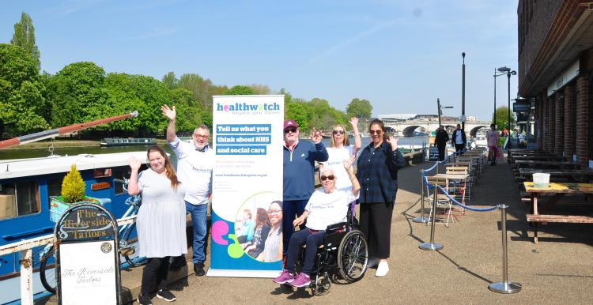
HWK Updates
- HW Kingston have been awarded a new contract, we can now continue the great work that we are already doing to give a voice to Kingston residents on their experiences of health and social care services for more information please visit the website:
Kingston Council awards new Healthwatch Kingston contract | Healthwatch Kingston
- Care Workforce Wellbeing: Engagement Report 2023,
to read the full report please visit our website:
Care Workforce Wellbeing: Engagement Report 2023 | Healthwatch Kingston
- Making Safeguarding Personal Report 22-23,
to read the full report please visit our website:
Making Safeguarding Personal Report 22-23 | Healthwatch Kingston

Slide 37
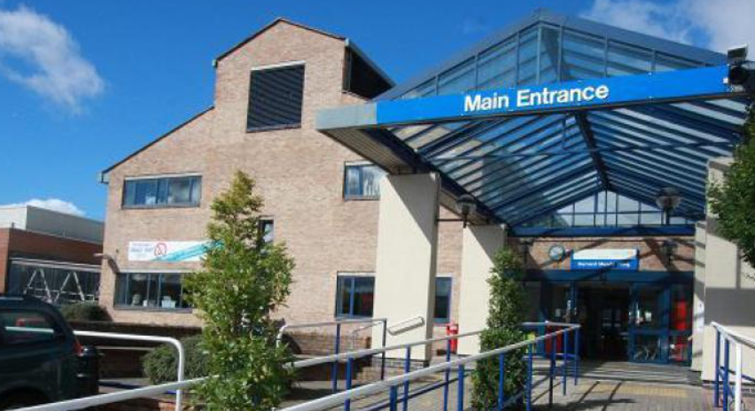
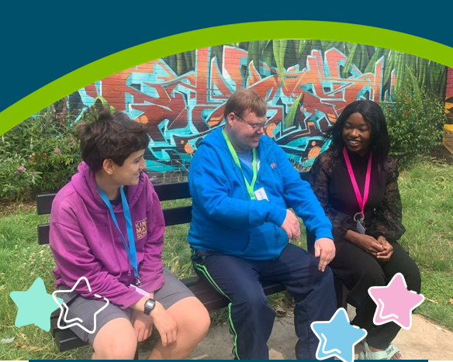
HWK Community Engagement Opportunities
- Annual London Safeguarding Adults Board Conference - 20 -24 November
We would like to invite you to join us online for the conference
Annual London Safeguarding Adults Board Conference: 20 -24 November | Healthwatch Kingston
- One year on - A virtual conversation about virtual wards
Join us on Tuesday, 21 November at 10.45am online For more information please contact Scott@healthwatchkingston.org.uk
- Volunteering with Healthwatch Kingston: Enter and View Training
HW Kingston are planning Enter and View training if you are interested in finding out November 23. For more details, please email candy@healthwatchkingston.org.uk

Slide 38
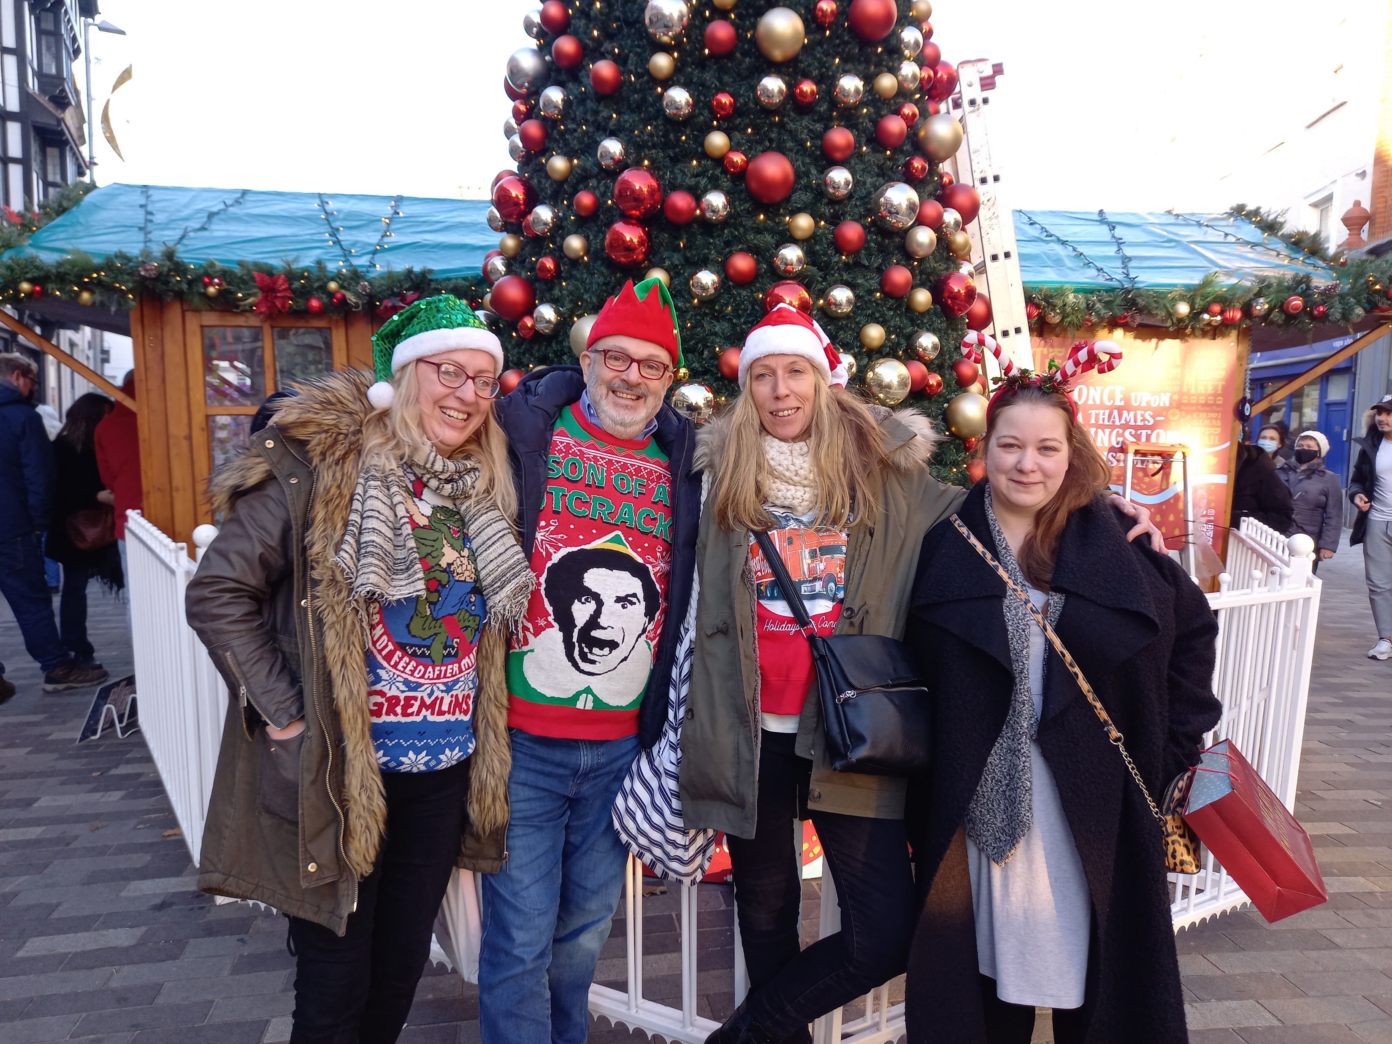
Thank you for joining us for the
Healthwatch Kingston
Open Meeting
See you in 2024!
Any question please email: info@healthwatchkingston.org.uk

