Slide 1

Healthwatch Kingston Open Meeting
Cost of Living, Health and Care Plan and Obesity
Tuesday 4th October 2022

Slide 2
HWK Open Meeting Agenda
Agenda
12.00pm – Welcome and settle in - Stephen Bitti, Chief Executive Officer, Healthwatch Kingston
12.15 – Cost of Living and Q&A - Martha Early, Corporate Head of Services, Public Health, RBK and Tony Laliashvili, Super Seniors Fitness
1pm 12.45pm – 15-minute break
1.15pm – Health and Care Plan and Q&A - Martha Early
1.45pm – Obesity and Q&A - Martha Earl, Martha Early
2.15pm - Healthwatch Community Surgery – Candy Dunne, Deputy Chief Officer, Healthwatch Kingston
2.30pm - Close

Slide 3

Cost of Living
Martha Earley, Corporate Head of Public Health, RBK

Slide 4
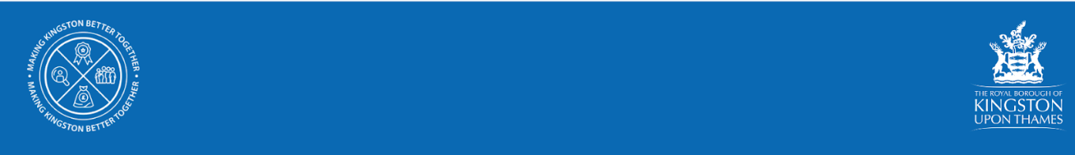
Cost of living crisis
Healthwatch Kingston
04 October 2022

Slide 5
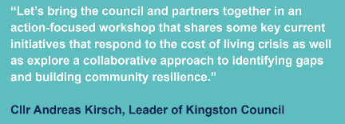
Cost of living crisis Workshop - 12 July 2022
Cllr Kirsch called a workshop on the Cost of Living crisis
The workshop explored 4 themes
Energy
Food
Income maximisation (money guidance and support)
Employment
Explored:
Support offered by Citizens Advice Kingston
Fuel and Food insecurity & the support offered by Kingston Food Banks, The Good Food Group, Kingston Stronger Together Hub with VCS partners and Thinking Works
RBK Financial support - assistance to council tenants and Adult Social Care Users who are facing financial difficulty.
Focus on older people’s incomes, the impact of the Cost of Living crisis on pensioners and what this means for quality of life (Staywell)
RBK Employment, Skills and Enterprise

Slide 6
Actions and next steps
As a partnership to share and raise awareness of the support and advice available in the borough and more widely and promote our webpage: kingston.gov.uk/costoflivingsupport
To inform residents about the support available to them in Kingston and engage with them on what other support they may need.
Partner communications leads working closely together to ensure the message is consistent and all frontline workers have the same information.
Develop an early intervention offer to identify those who could fall through the gaps (e.g. by developing three core screening questions and embedding these across the partnership)
Further develop local information for residents, including mapping resources and ensuring effective communications (including potential for warm hubs and digital access)

Slide 7
Actions and next steps - community/warm spaces
Mapped what’s being offered across the borough
Use existing buildings and spaces which are easily accessible to residents, includes council buildings such as libraries, leisure centres and community spaces
To develop a collaborative approach to offer warm spaces for people to sit and have a hot drink - potentially also access wifi and advice
To offer spaces where services, advice and signposting can be accessed, provided by organisations across the borough
To engage with residents and offer activities to reduce isolation
Some spaces will be for advice and signposting only - offer tailored to space
Support residents through Community Library Service and Adult Social Care services, visiting people in their own homes
To work with organisations who support people in their own homes to offer consistent sharing of information and resources
To check on service users who may be vulnerable adults and to signpost / escalate need if appropriate

Slide 8
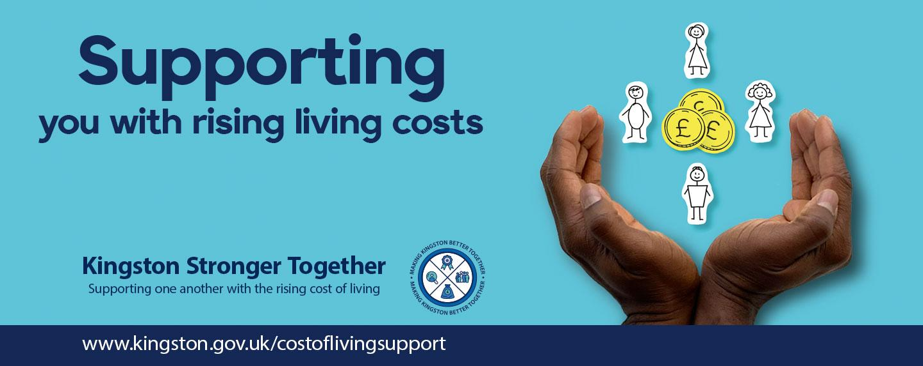
Local support available

Slide 9
RBK: Household Support Fund
Thanks to fantastic partnership working, we were able to successfully support over 2500 households in the previous rounds of this scheme as well as provide over 12000 vouchers to families with children on Free School Meals. We would like to continue to reach as many households as possible, who are need of support.
Kingston has been granted up to £860,000 from the Department of Work and Pensions in a third round of funding to support low income households in Kingston, who are struggling to afford food, utility bills and other essentials.
This funding runs from 1 October 2022 - 31 March 23.
Applications can be made by professionals on behalf of a resident or residents can apply directly via RBK’s website and is a short Google Form.
Any enquiries: householdsupportfund@kingston.gov.uk or telephone RBK’s contact centre of 0208 547 5000 requesting a call back from the Household Support Fund team.

Slide 10
Voluntary & Community Sector grants
We are inviting Voluntary and Community Sector organisations to apply for projects that will help people stay warm and well, and access meals and equipment and support.
The funding retains flexibility in how this money can be spent and we are hoping to include the following:
  Nutritional meals for residents, especially clinically vulnerable residents.
  Warm Spaces for residents to attend.
  Support with food; energy/utility bills, essentials e.g. bedding, boiler repairs, clothing.
  Provision of household equipment to help with keeping warm, eg. electric blankets, hot water bottles and thermos flasks.
For more information is available on the RBK website or email the team.

Slide 11
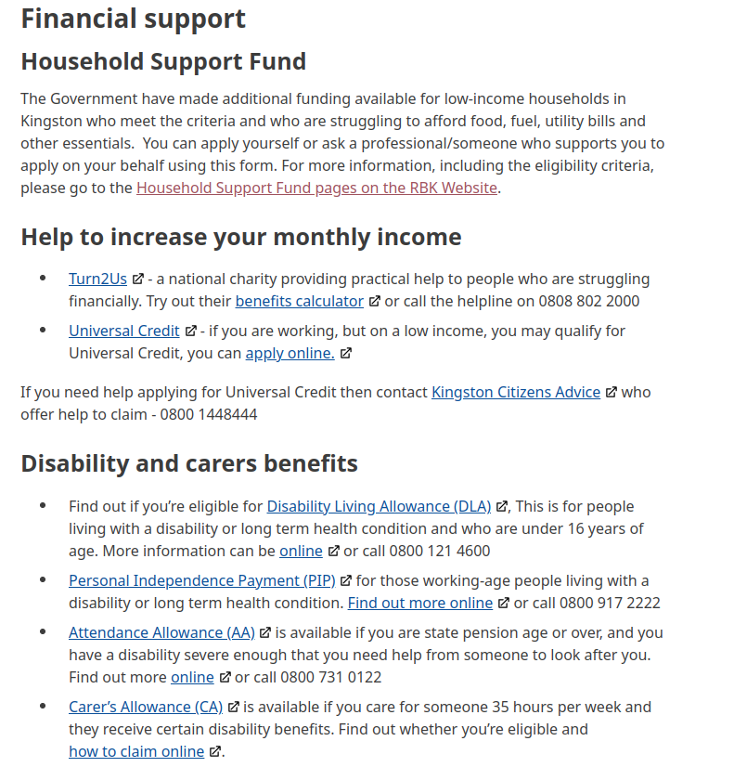

RBK: Cost of Living
https://www.kingston.gov.uk/costoflivingsupport

Slide 12
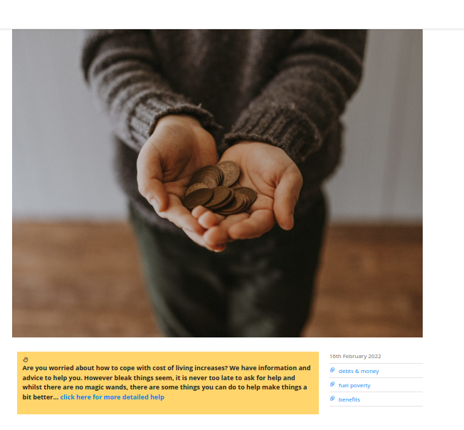
CAK: Cost of Living Toolkit
https://www.citizensadvicekingston.org.uk/?portfolio=cost-of-living-crisis-2
Information and advice to help local people cope with the cost of living increases. Find out more information by calling 020 3166 0953.

Slide 13
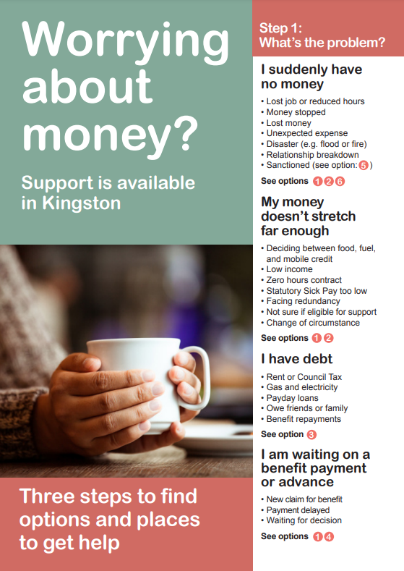
Worrying About Money
Leaflet PDF: https://ifanuk.org/kingston-leaflet
Digital Version: https://www.worryingaboutmoney.co.uk/kingston

Slide 14
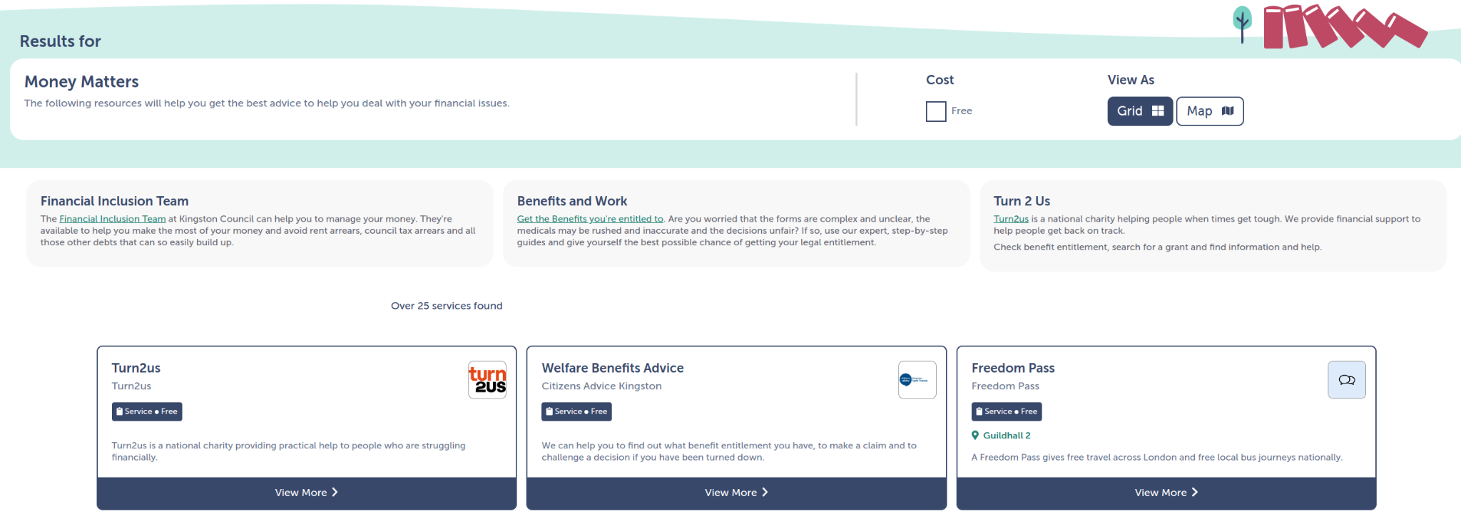
Connected Kingston: Money Matters
https://www.connectedkingston.uk/results?category=9857fe1c-17dc-4994-819d-1977ea416633

Slide 15
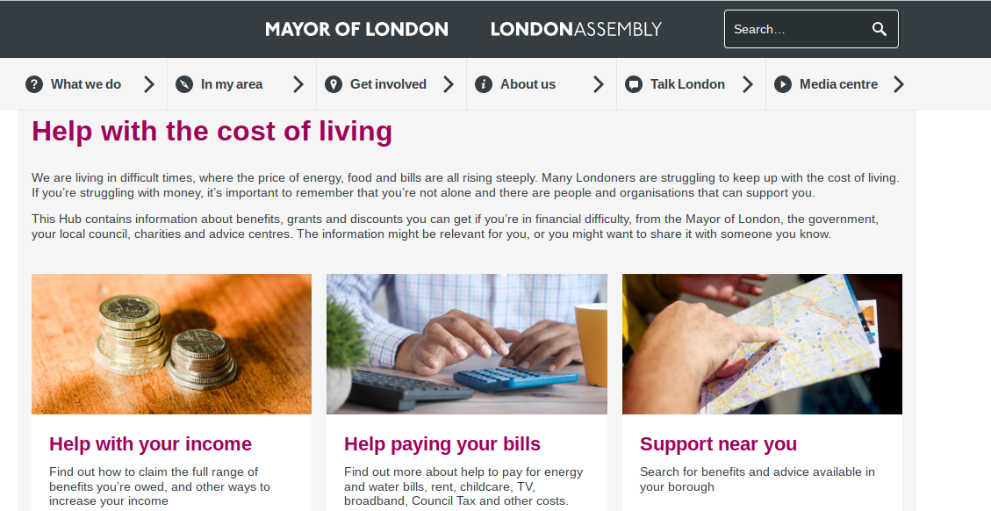
GLA Cost of Living Toolkit
https://www.london.gov.uk/what-we-do/communities/help-cost-living

Slide 16
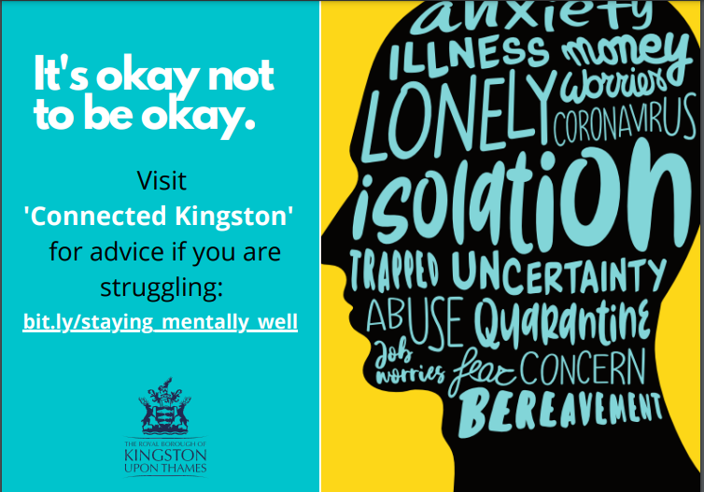
Mental Health support
Connected Kingston (www.connectedkingston.uk/)
Connected Kingston lists a range of services and support
available across Kingston bit.ly/staying_mentally_well).
Mental Health First Aid
Mental Health First Aid (MHFA) is a training course which teaches people how to identify, understand and help someone who may be experiencing a mental health issue.
Online 20 minute suicide prevention training: https://www.zerosuicidealliance.com/training
For details of future MHFA training contact Niza.ravi@kingston.gov.uk

Slide 17
Mental Health Links - emotional support
GLA Cost of Living Toolkit - money worries and mental health
Struggling with money and debt can be a stressful & lonely experience.
Whether you would like to feel more in control of your finances, or would like specific support for your mental health, there are options available to help you feel better.
Support helplines are available for those in need of emotional support.
  Samaritans - confidential support service for anyone experiencing distress or despair
  Papyrus - helpline service to under 35s experiencing thoughts of self-harm or suicide
  CALM (Campaign Against Living Miserably) - helpline for anyone who needs help.
  The Silverline - anyone over 55 to provide friendship, conversation and support

Slide 18
Information gathering
KVA and RBK are developing a Cost of Living section on the Connected Kingston website. We would like to tag as many offers as possible. Please do let us know of any service that could be added under this category
Exploring data: RBK Data and Insight are looking at local data sources to understand need. What information do you have? How can we identify people earlier?
Are there groups that we need to target (where people are particularly vulnerable)

Slide 19
Please complete the Google form or get in touch
In this presentation we have considered the importance of using data to inform our approach (including which groups to target for support). We also talked about the importance of signposting to the right services on Connected Kingston. Therefore questions have been included below to collect this information. If you would prefer to email or chat this through please contact katharine.dallas@kingston.gov.uk
https://docs.google.com/forms/d/e/1FAIpQLSfPxZvCDnCI11Sn0KIgzEMl-HFvFqzSkH8VFui1JhBma1R8rg/viewform?usp=sf_link

Slide 20
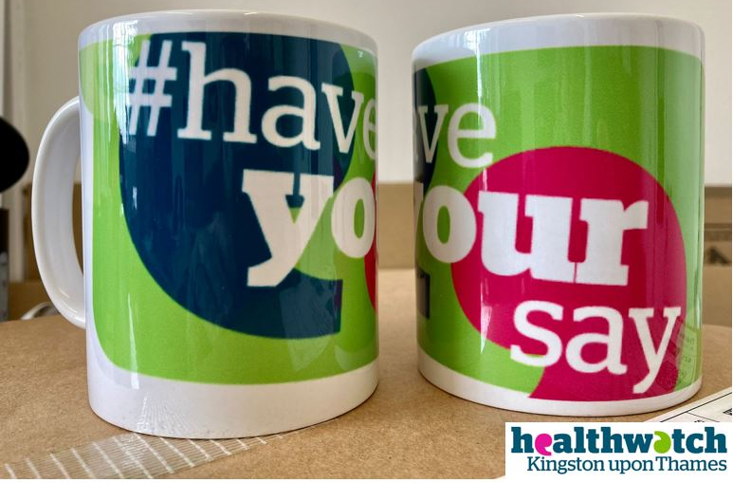
Break (1pm – 1.15pm)

Slide 21
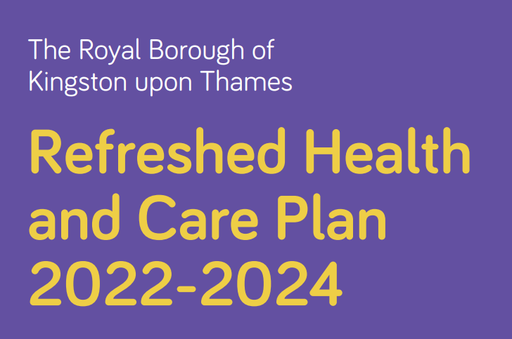
Health and Care Plan
Martha Earley, Corporate Head of Public Health, RBK

Slide 22

Kingston’s Health and Care Plan 2022-2024
Refreshed to produce a new two year plan highlighting system priorities
Kingston Healthwatch Meeting
4th October 2022
Martha Earley, Corporate Head of Service, Public Health

Slide 23
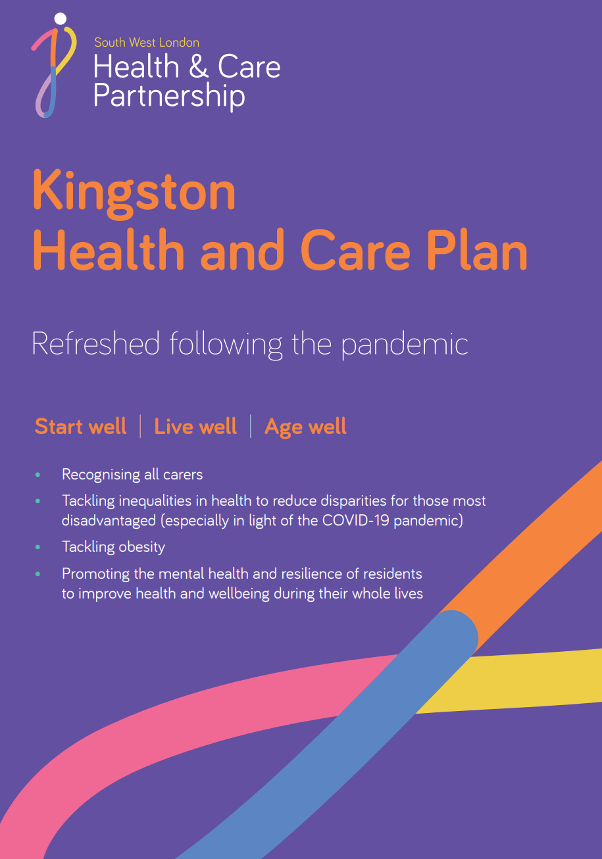
2022-2024 refresh
Kingston’s refreshed draft of the Health and Care Plan 2022-2024 describes our vision, priorities and the actions we will work on together as partners to improve the health and wellbeing of Kingston’s residents.
The plan was first published in 2019 with the aim of key organisations working together on priorities that would make the difference in enabling Kingston residents to start life well as children, live well as adults and for older people to age well for longer.
The new two-year plan for 2022-2024 is a refresh of some of the existing priorities with a new focus on tackling health inequalities across the life course, tackling obesity, improving mental health and improving the lives of carers.

Slide 24
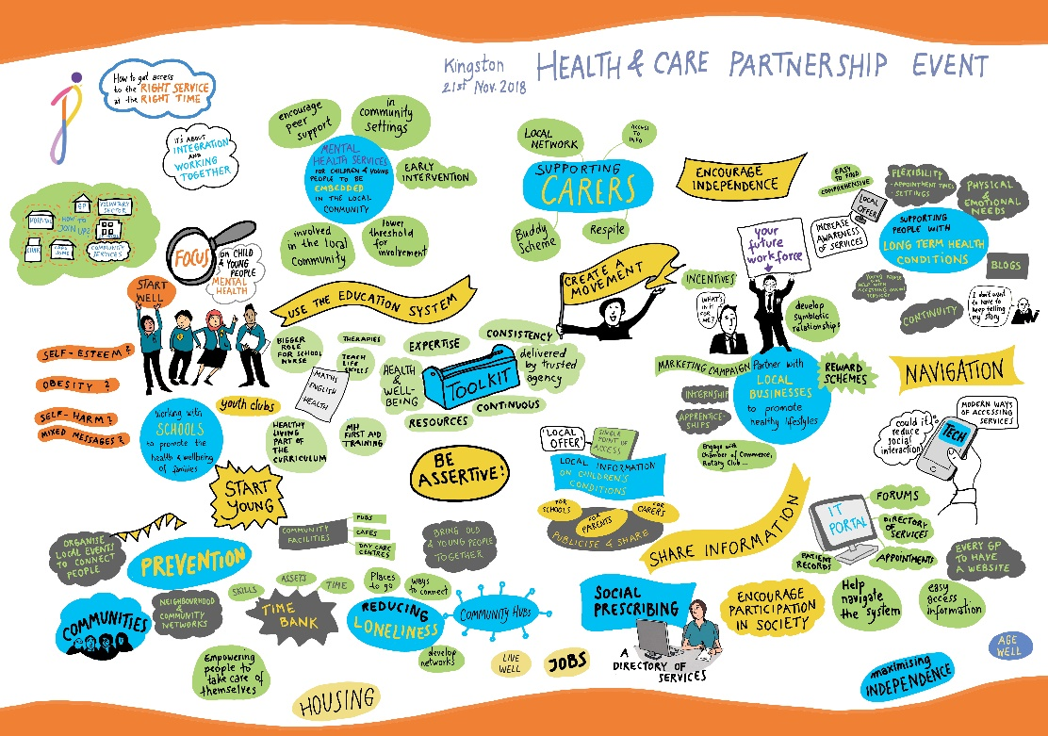
Building on insight from local people in 2018-2019
During 2018-2019 we ran extensive engagement to hear from and test ideas with local people at different stages in the development of our first health and care plan.
The health and care plan event we held was an opportunity for us to hear from the ‘silent majority’ people who had not previously been involved with us in sharing their views on local health and care services.
We wanted to make sure we spoke to a wide range of local people either directly, or through local patient groups and community organisations.
We wanted to hear from those who would be most….. impacted by proposals in the plan.
Notes:
Building on the previous engagement with local people and insight gathered from partners during the pandemic.

Slide 25
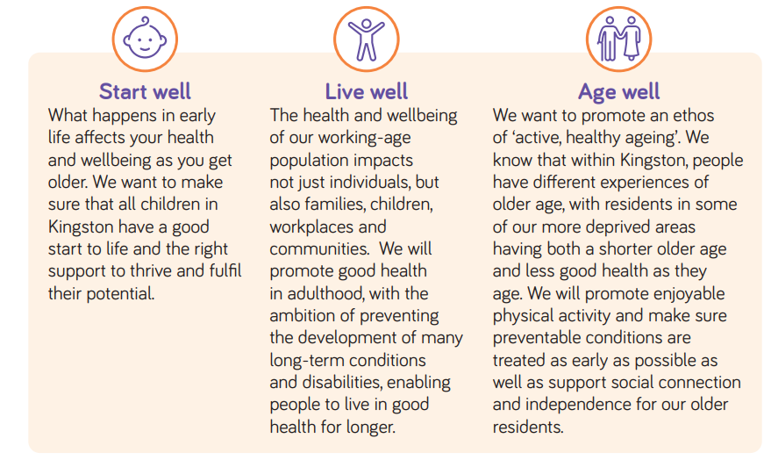
Our vision

Slide 26
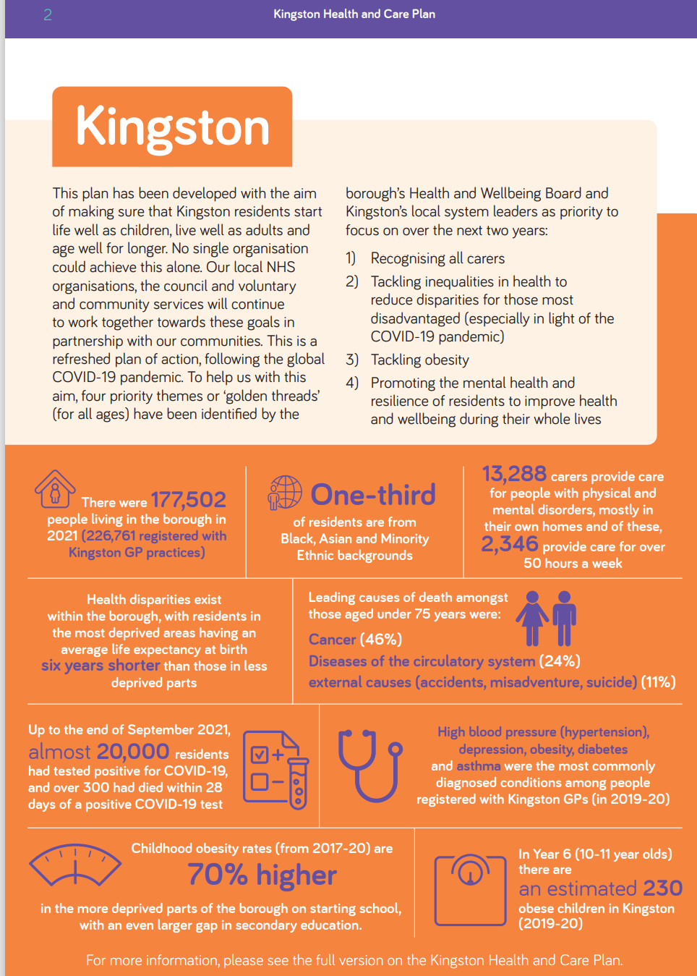
Overarching themes
Four overarching themes, identified by the borough’s Health and Wellbeing Board and local system leaders, underpin the plan:
Recognising and supporting carers of all ages.
Tackling inequalities in health to reduce disparities for those most disadvantaged (especially in light of the COVID-19 pandemic).
Tackling obesity in all ages, enabling people to live physically active and healthy lifestyles, at a healthy weight, to prevent ill-health and improve wellbeing.
Promoting the mental health and resilience of residents to improve health and wellbeing their whole lives.

Slide 27
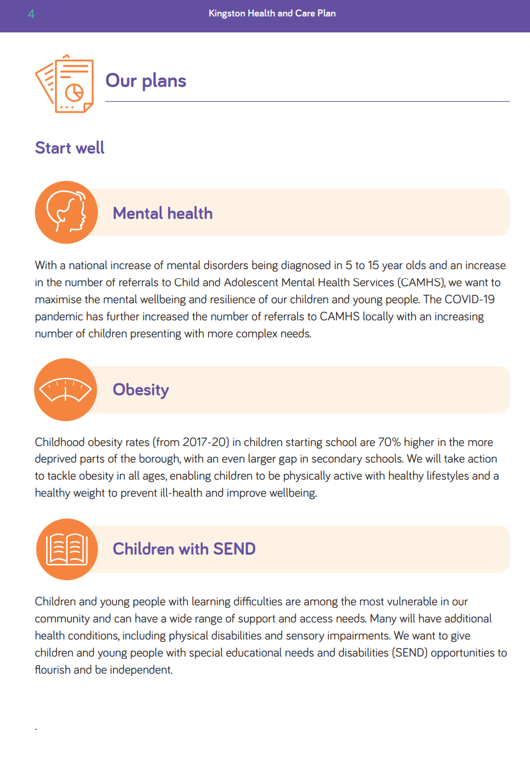
Start well
Maximise the mental wellbeing and resilience of our children and young people.
Improve the health and wellbeing of children and young people by tackling childhood obesity.
Give children and young people with special educational needs and disabilities opportunities to flourish and be independent.
Our vision

Slide 28
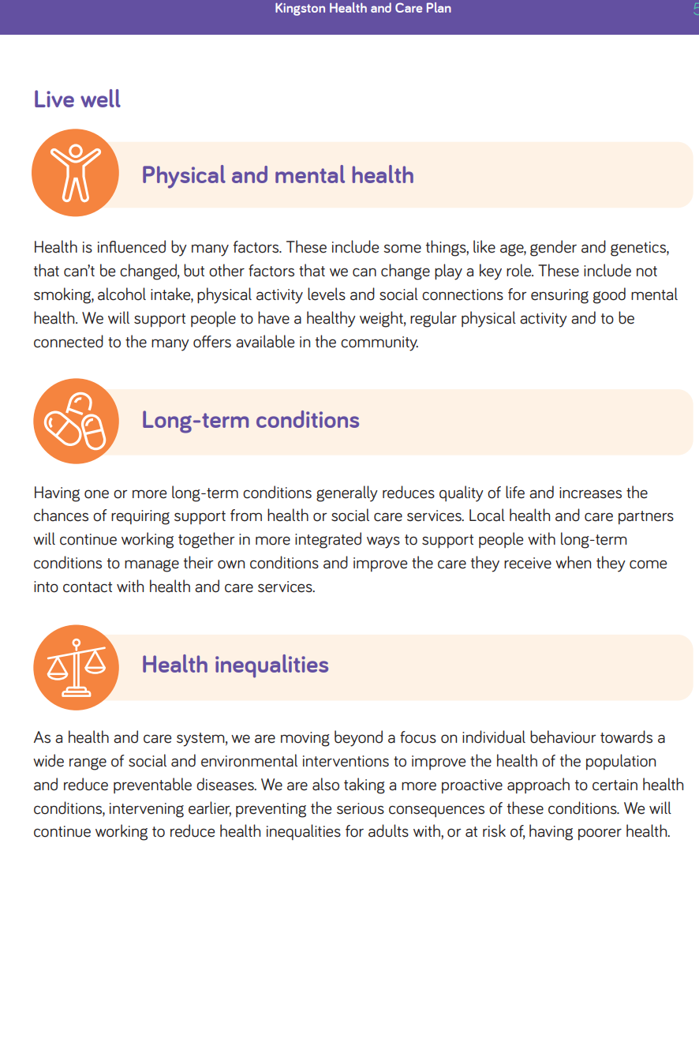
Live well
Support people to stay healthy, physically and mentally.
Support those people with long-term conditions.
3. Reduce health inequalities.
Our vision
Our vision
Our vision
Our vision

Slide 29
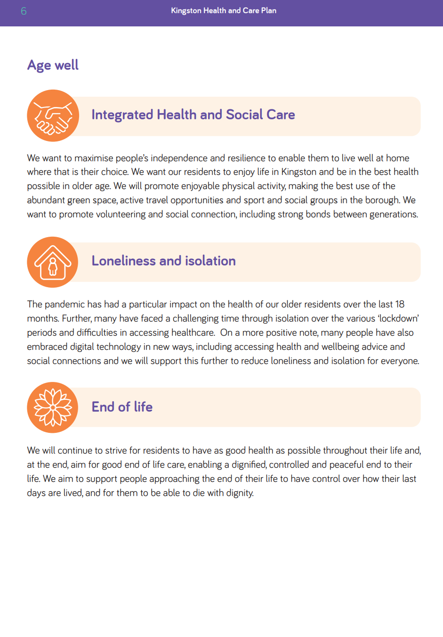
Age well
Encourage active, resilient and inclusive communities that promote healthy ageing.
Reduce loneliness and isolation for everyone.
Support people to plan for their final years so they have a dignified death in a place of their choice.
Our vision

Slide 30
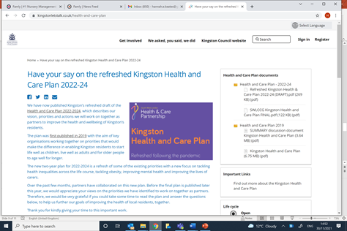
Have your say
We ran an online survey during November on Kingston Council’s Let’s Talk portal to gather views on the priorities we identified and ask for feedback
  Over 100 people completed the survey
  Over 1000 views of the plan
Demographics of respondents:
  70% female
  41% are aged 55-64, followed by 30% in the 65-70 age group
  91% are white
  29% have a long-term health condition or disability
  21% are carers
  72% commented as local residents, 24% work in Kingston
Notes:
Final engagement report will be produced during December once survey closes on 30 November

Slide 31
Have your say – survey results
70% of respondents agree with the priorities and actions set out in the plan
97% understand what we will be focusing on over the next 2 years
87% agree with the actions we are proposing to improve the health and care of local people over the next 2 years
62% thought however that there was something missing from the plan, with two common themes emerging:
  ‘Long covid plans and support isn’t mentioned, despite being a refresh following the pandemic’
  ‘Active travel has huge scope to alleviate the key health issues in the borough’
Any other comments were far ranging, but three areas were mentioned more than once:
  ‘please cater for those with just physical disabilities when updating the plan’
  ‘focus on early years to reduce negative outcomes for people’
  ‘need to look at primary care (GP) provision’
This feedback was reported at Health and Wellbeing Board and has since been incorporated into the plan
Notes:
These will be taken into account when finalising the plan – and the results of the survey once it is fully analysed after the closing date.
Primary care is beyond the remit of the HCP as a partnership plan, but the feedback on GP practices will be fedback to the primary care team at the CCG.

Slide 32
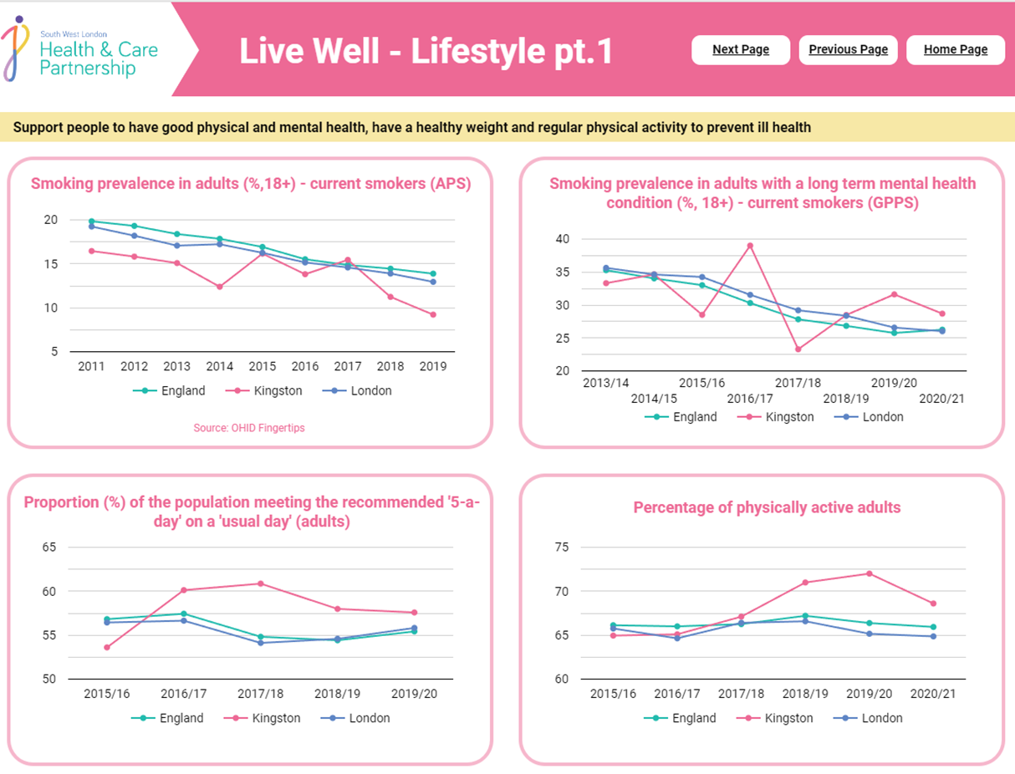
The plan has been published on the Council and the SWL NHS websites. It may be found here: https://www.southwestlondonics.org.uk/publications/kingston-health-and-care-plan-2022-to-2024/
The dashboard of metrics we have developed is being presented to the new Kingston Partnership Board on the 6th October 2022. Once published, this will be available for the Board and the public to view our progress against these indicators.
Notes:
These will be taken into account when finalising the plan – and the results of the survey once it is fully analysed after the closing date.
Primary care is beyond the remit of the HCP as a partnership plan, but the feedback on GP practices will be fedback to the primary care team at the CCG.

Slide 33
What happens next?
Kingston’s Health and Wellbeing Board approved the plan in November 2021
The plan has been implemented since January 2022 and will run until 2024
New metrics have been developed to measure progress, using a dashboard which will be made available for the public.
Kingston’s new Place Partnership Committee (Integrated Care System) receive presentations and updates on programmes of work within the plan.
The new Kingston Partnership Board (replacing the Health and Wellbeing Board and Kingston Strategic Partnership will also have themes & regular updates).
Thank you for giving your time to this important work.
Any questions?

Slide 34
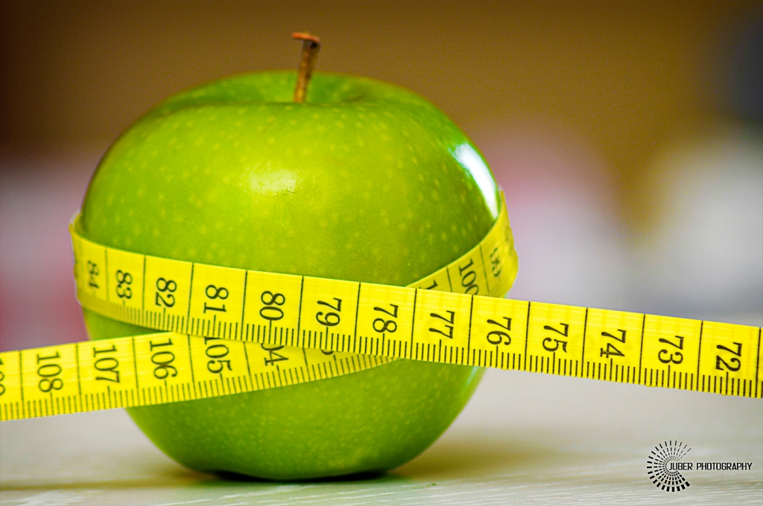
Obesity
Martha Earley, Corporate Head of Public Health, RBK

Slide 35

Healthy Eating and Physical Activity in the Royal Borough of Kingston upon Thames
4th October 2022
Martha Earley
Corporate Head of Service, Public Health
Royal Borough Kingston Council

Slide 36
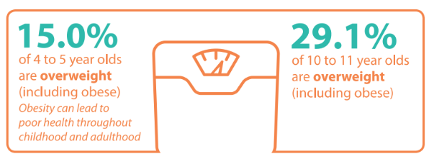
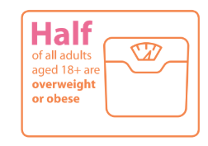
Health and Care Plan 2022-2024 refresh
Kingston’s refreshed Health and Care Plan 2022-2024 describes our vision, priorities and the actions we will work on together as partners to improve the health and wellbeing of Kingston’s residents.
The new two-year plan for 2022-2024 is a refresh of some of the existing priorities to start, live and age well with a new focus on tackling health inequalities across the life course, improving mental health, improving the lives of carers and…tackling obesity, hence this presentation on a healthy weight and physical activity!

Slide 37
Why we need to tackle Obesity
Obesity is associated with higher risks of type 2 diabetes, heart attacks, strokes, many of the common cancers, and is also linked with more severe COVID-19 outcomes.
Reducing obesity levels will save lives as obesity doubles the risk of dying prematurely.
High economic costs; It was estimated that the NHS in England spent £5.1 billion on overweight and obesity-related ill-health in 2014/15
The burden is falling hardest on those from low-income backgrounds. Obesity rates are highest for children from the most deprived areas and this is getting worse.
At its root obesity is caused by an energy imbalance: taking in more energy through food than we use through activity.
However, obesity is a complex problem with many drivers, including not only our behaviour but the environment, our genetics and culture.
Notes:
ref : https://assets.publishing.service.gov.uk/government/uploads/system/uploads/attachment_data/file/546588/Childhood_obesity_2016__2__acc.pdf

Slide 38

Royal Borough of Kingston is a Marmot Borough
The Marmot review highlights that the following population groups are at higher risk of overweight and obesity than others: Families with a low income Communities with high deprivation People from certain ethnic groups, such as Black, Asian and mixed heritage Those with a limiting illness or disability.
www.instituteofhealthequity.org/resources-reports/marmot-review-10-years-on/the-marmot-review-10-years-on-full-report.pdf

Slide 39
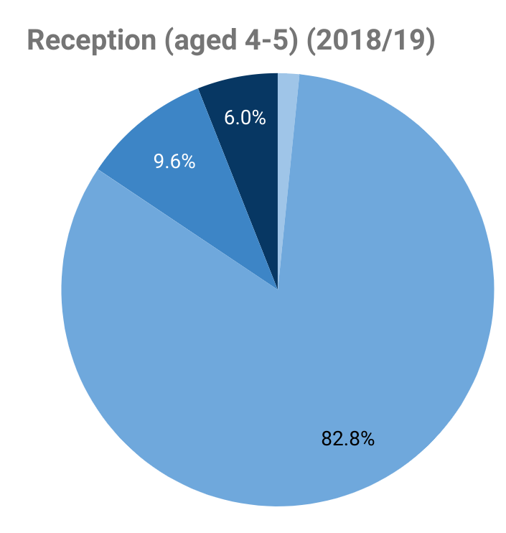
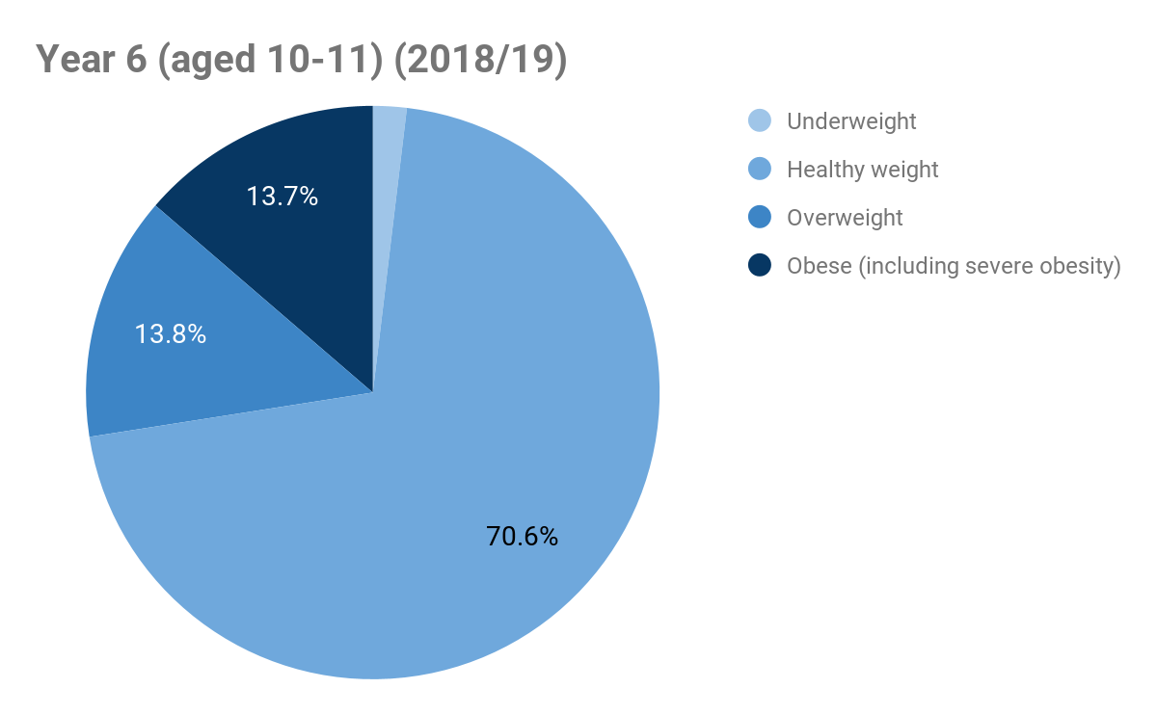
Weight status of school aged children in Kingston (NCMP))
975 children are overweight or obese in Reception, this more than doubles to 1925 in Year 6.
These charts show children who are overweight in reception are likely to become obese in Year 6 and
an additional 950 children will become overweight.

Slide 40
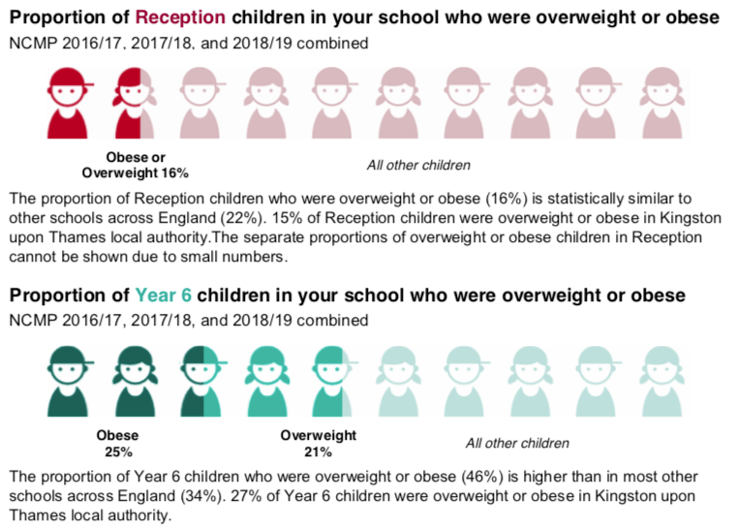
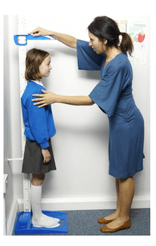
NCMP Example – A Primary School in Kingston
Overall overweight/obesity in Kingston may be lower than national average but this varies by Ward & school
Several Wards/schools in Kingston are above national average
Notes:
NCMP – Robin Hood Primary School

Slide 41
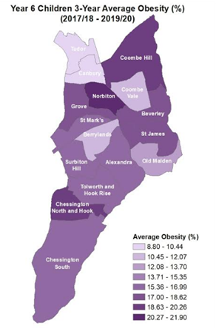
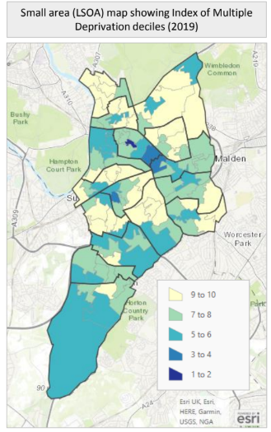
Childhood overweight and obesity
Obesity prevalence in the most deprived 10% of children is approximately twice that of the least deprived 10% (national)
Consider supporting active travel measures in high obesity areas
Notes:
The darker areas also reflect our areas of high deprivation. *Coombe Hill is an area of affluence however, Kingsnympton Estate is one of the borough’s most deprived areas and Robin Hood School, serving the estate has some of the highest levels of obesity in the borough

Slide 42
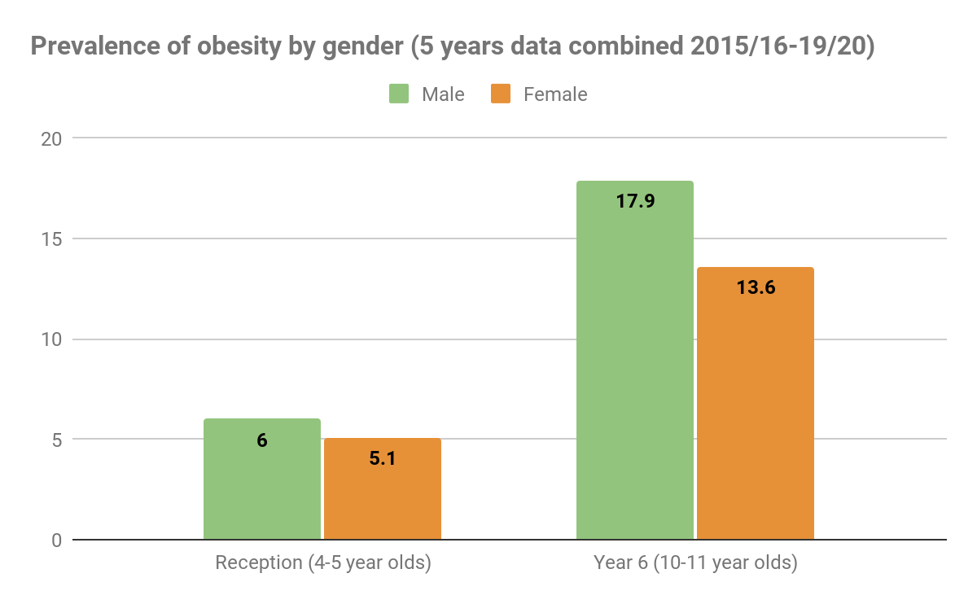
Obesity and Gender
Prevalence of obesity is higher in boys than girls.
For males, the prevalence of obesity almost triples from reception age (6% of males) children to year 6 (17.9% of males).

Slide 43
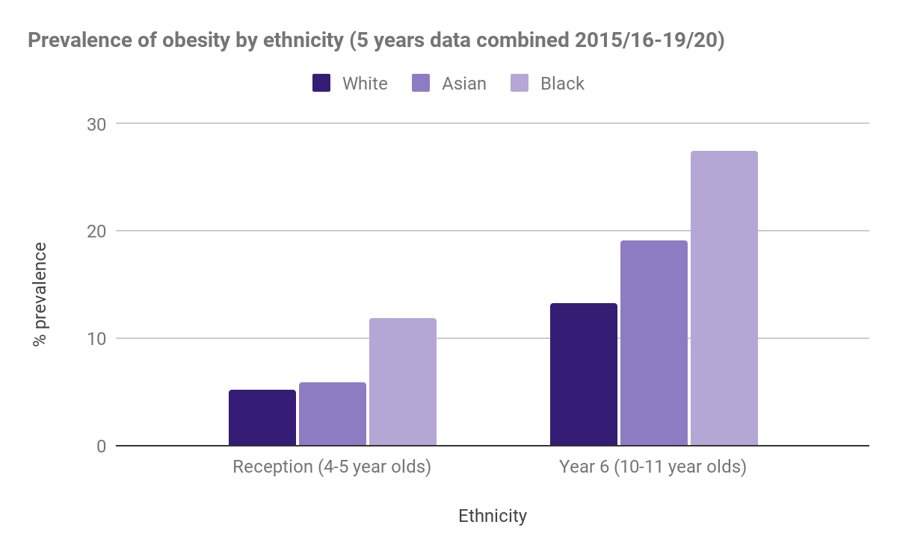
Obesity and Ethnicity
In Kingston, the prevalence of obesity is highest in Black ethnic groups
27.5% of year 6 children from Black ethnic groups are classified as overweight.
This follows the national trend.
Although NCMP data relates to childhood, they reveal patterns of inequality seen throughout the lifecourse which need to be addressed early in life as part of an effective obesity prevention and management strategy.

Slide 44
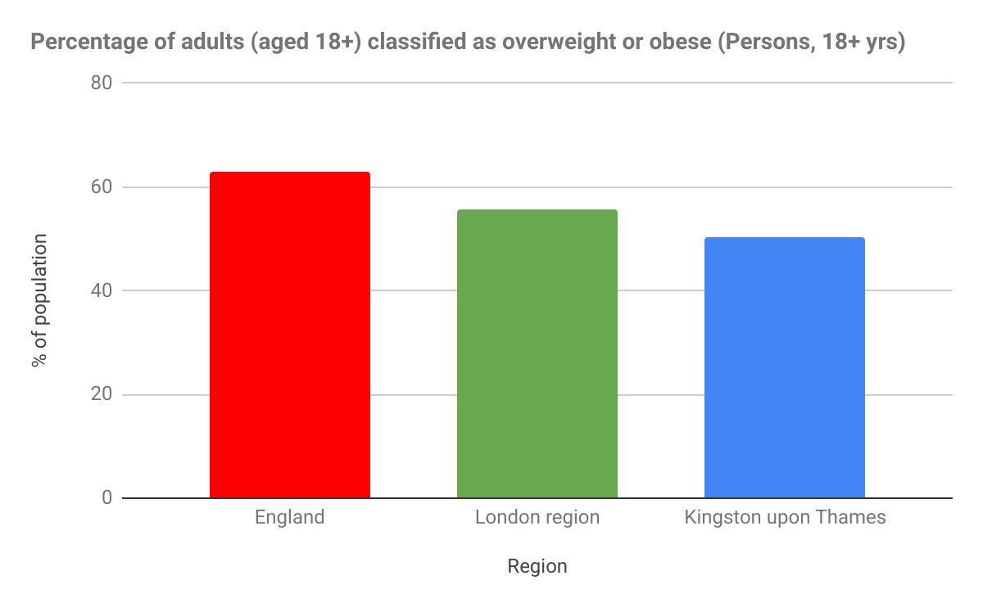
Adult Obesity Data
In Kingston, 50.4% of adults are classified as overweight, this compares to 55.7% in London and 62.8% in England.
Whilst this is lower than England, it still equates to approximately
88,000 overweight adults in the borough.
https://fingertips.phe.org.uk
Notes:
How can we help these adults achieve a healthy weight?

Slide 45
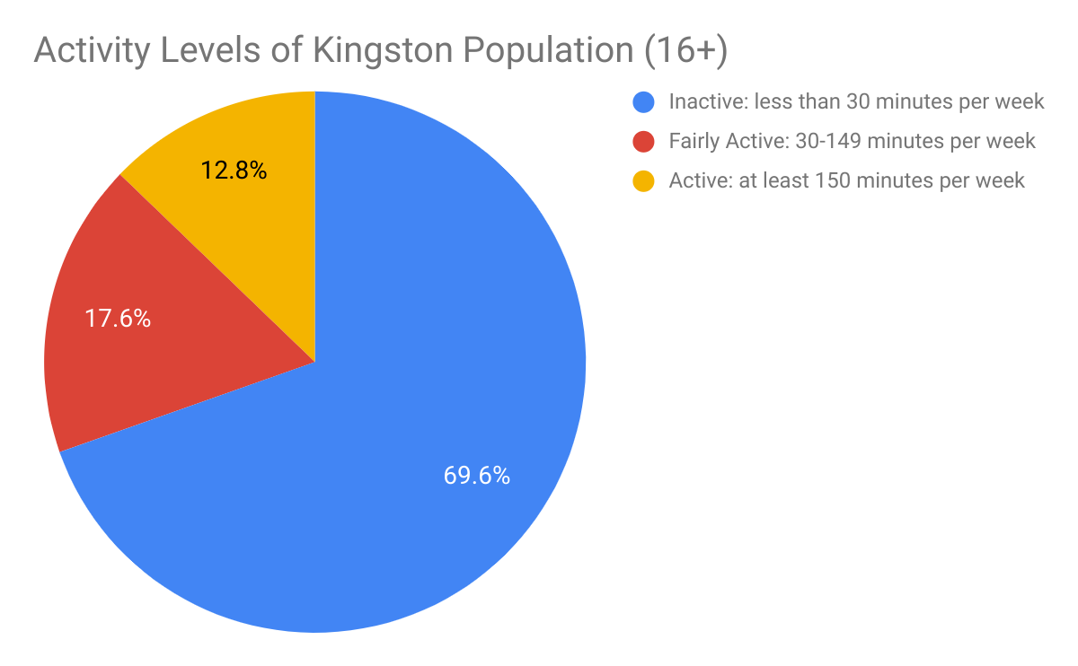
Adult Activity Levels
Data from Active Lives Survey, shows that 17.6% of the population are not active for more than 30 minutes a week, this is approximately
25,000 inactive residents in Kingston .
Notes:
HOw can we enable these adults to live a physically active life? What should we be doing?

Slide 46
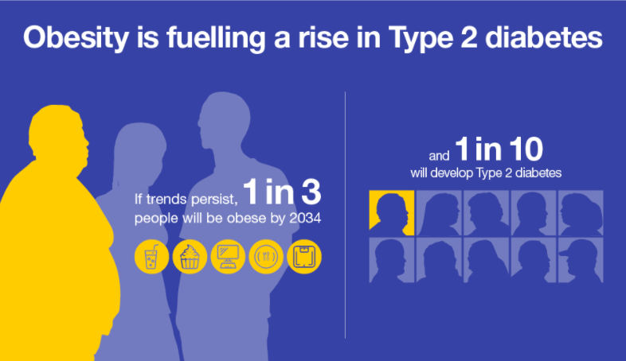
Diabetes and other long term conditions - disparities
8,823 people with diabetes in Kingston recorded by GP, increasing trend (2019/20)
Prevalence of Type 2 diabetes is 60% more common among individuals in the most deprived quintile compared with those in the least deprived quintile in England.
Healthy Life expectancy gap in Kingston: the poorest are in worse health in old age earlier, by 8 yrs for men on a low income, and 7 yrs earlier for women on a low income

Slide 47

Beyond the Council - taking system-wide approaches (involving several organisations and our communities)
Marmot Principle 1: Giving every child the best start
London’s Childhood Obesity Taskforce

Slide 48
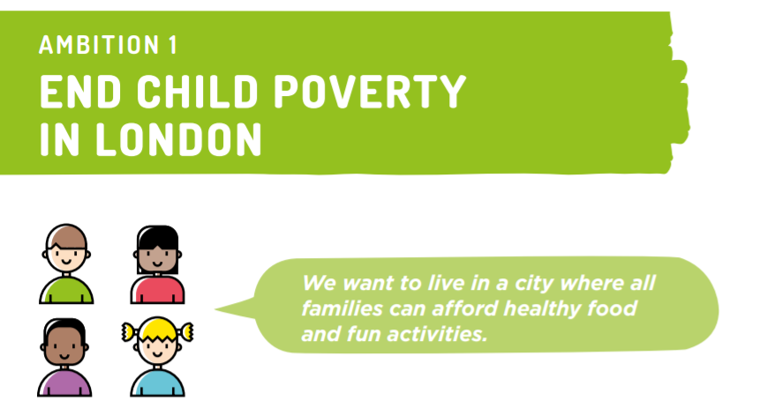

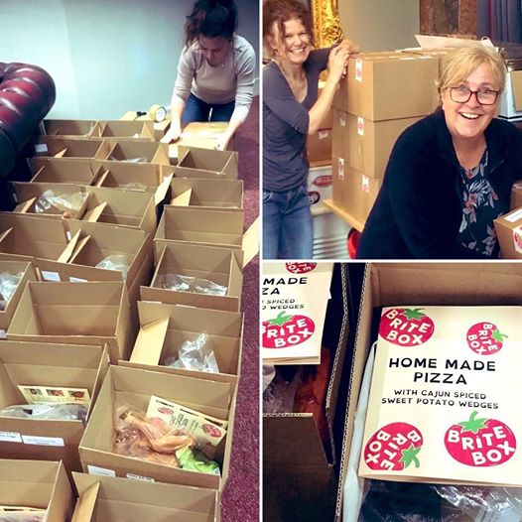
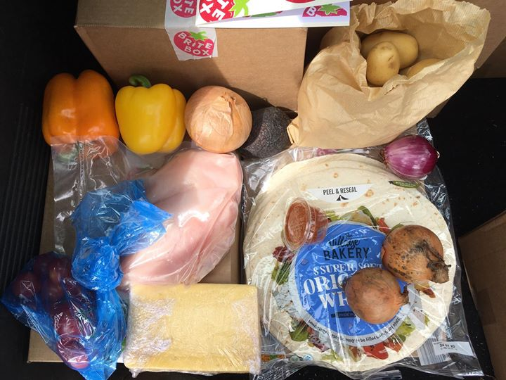

RBK have led the multi-agency Good Food Group to tackle food insecurity working on;
1) Co-ordinated food distribution to vulnerable families
2) Increase uptake Healthy Start vouchers (fruit, veg, milk £4)
3) Provide holiday provision of food and activities
4) Increase awareness of the voluntary sector offers of support
Working with Voices of Hope during our food distribution in response to Covid-19, a new project emerged to reach families who’re struggling. Brite Boxes are for disadvantaged families to learn about nutrition and cooking.
Hundreds of boxes a week are now going out for families across Kingston and Richmond on a low income.
We are soon to pilot more Brite Box work in local schools, in partnership with Kingston Hospital
Notes:
Massive decrease in fruit and vegetable intake reported by children receiving free school meals following lockdown
In a study conducted by Northumbria University’s Healthy Living Lab around half of the children who received free school meal vouchers are reporting a significant drop in their intake of fruit and vegetables since schools closed in March.
http://newsroom.northumbria.ac.uk/pressreleases/massive-decrease-in-fruit-and-vegetable-intake-reported-by-children-receiving-free-school-meals-following-lockdown-3005719

Slide 49
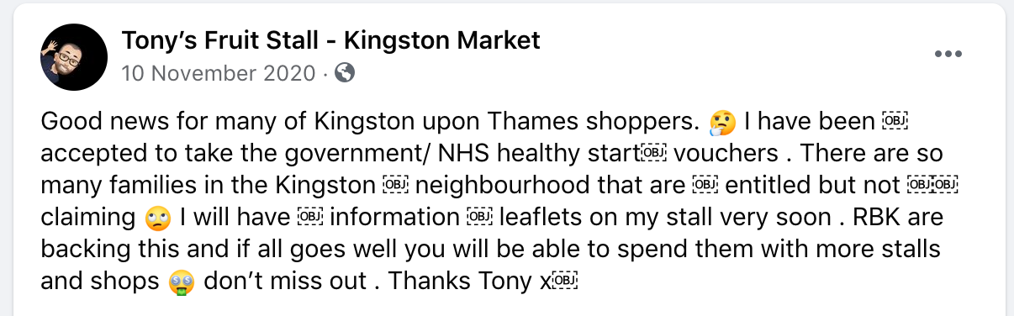
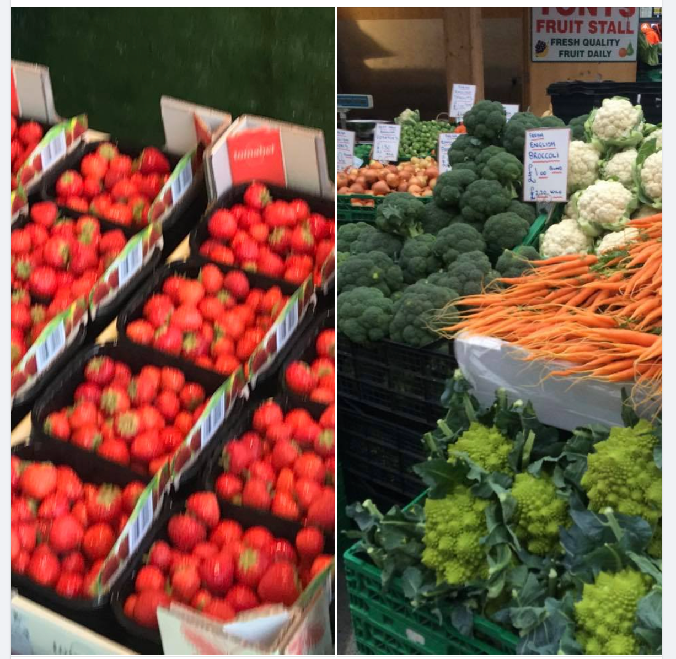
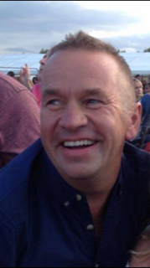
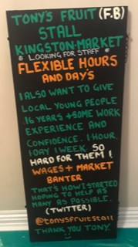

Local Food and Retail Heros!
The Good Food Group secured funding for a Good Food Retail project in 2020 to map food deserts, support retailers to accept Healthy Start vouchers and sell healthy foods.
Engaging with local retailers can make the difference to local people on what is available to them!
‘Community Pantry’ is now open in Tolworth! (Sept ‘22)

Slide 50
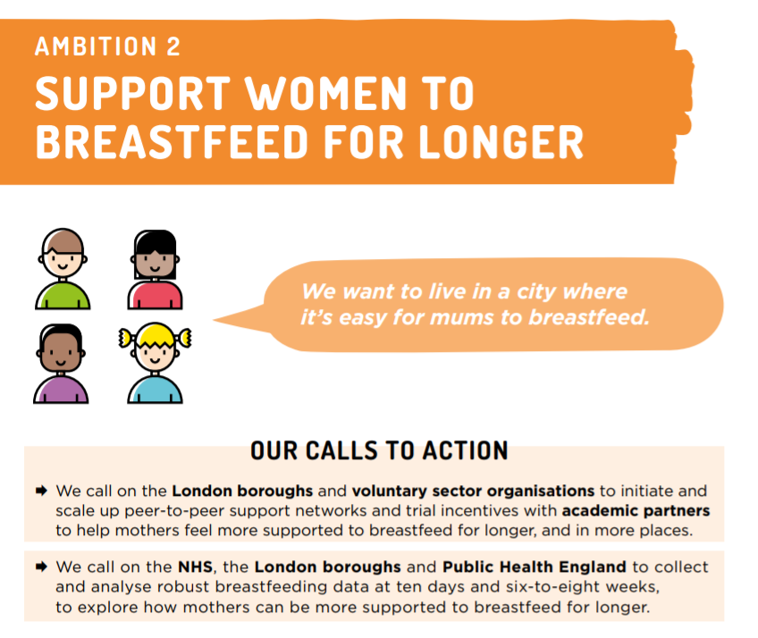

The Infant Feeding Partnership, chaired by Public Health Kingston, has a multi agency Infant Feeding Action Plan
Our target is for full UNICEF Accreditation across the borough
  Health Visiting has achieved Level 3
  Hospital in the process of Level 3
  AfC Children's Centres Level 2
Robust data is collected at 10 days and six-to-eight weeks.
Hospital and community data is shared at meetings between multi-agency professionals and mother’s representative groups to inform where targeted work is required next
Exclusively breastfeeding provides protection against childhood overweight and obesity.
In Kingston, 77% of mothers are still breastfeeding at 6-8 weeks which was even maintained during COVID-19 restrictions. This is compared to 46% in England.
Notes:
Call to action to scale up peer to peer support and collect and analyse robust breastfeeding data at ten days and six to eight weeks
England has the lowest breastfeeding rate of any country in the world
Based on the available evidence, breastfeeding appears to provide some level of protection against childhood overweight and obesity. Together with other targeted nutrition interventions, breastfeeding can therefore be an important component of strategies to reduce the risk of overweight and obesity in children.

Slide 51
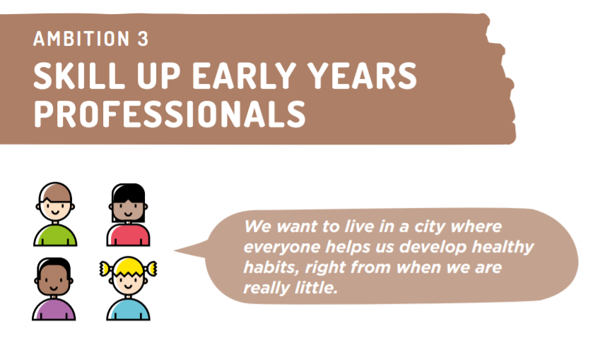
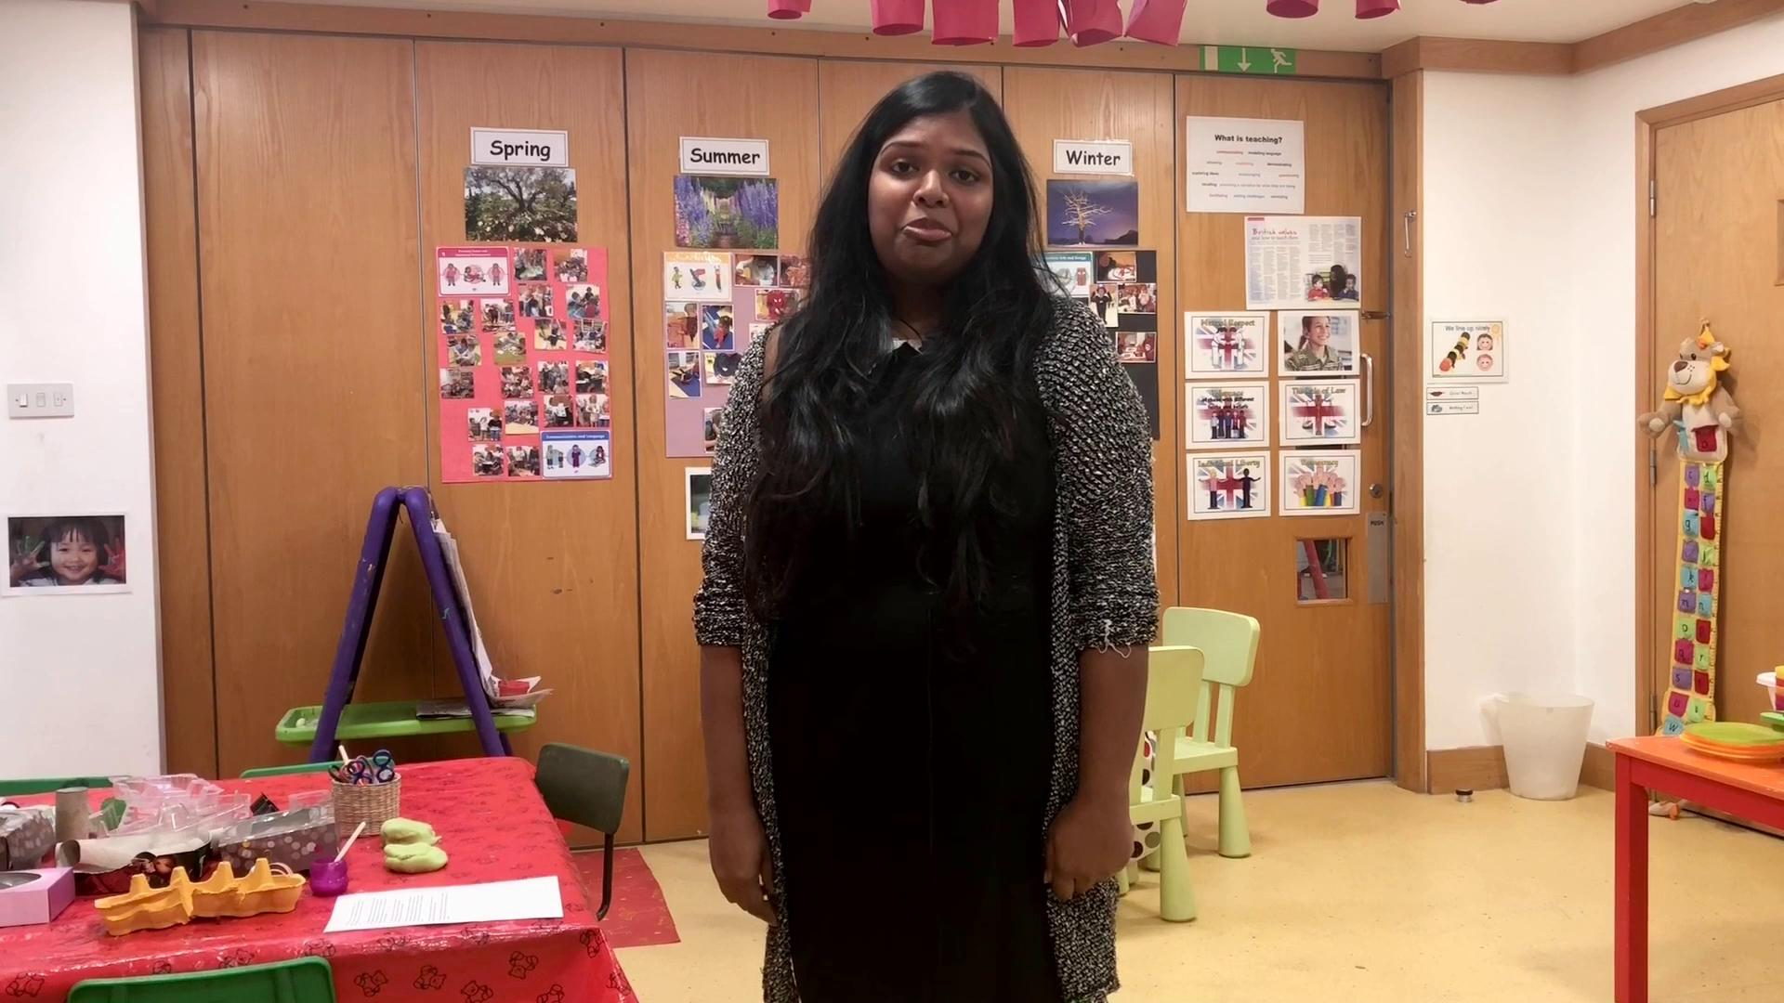

The HENRY programme is a whole-family approach to achieving and maintaining a healthy weight from pregnancy to the end of primary school.
Following the successful implementation of the HENRY Healthy Families Right From the Start the service has delivered the following:
HENRY groups delivered
Additional practitioners trained in HENRY core skills from 0-19 service
8 Early Years practitioners trained in HENRY Healthy Start in Childcare
Offer of Raise, Engage Refer training in partnership organisations (AFC, VCS)
Expanded to offer the HENRY 5-11’s Healthy Families Growing Up programme delivered by School Health and supported by BriteBox
AfC and PH supporting all early years setting in the borough to achieve Health in Early Years awards (Mayor of London Scheme)
7 settings have achieved Bronze and a further 9 are drafting their Bronze award applications
Notes:
Call to provide core training programme for early years workforce and NHS staff who engage with young children and their parents
Food training and required qualifications for all early years setting with caterers and chefs

Slide 52
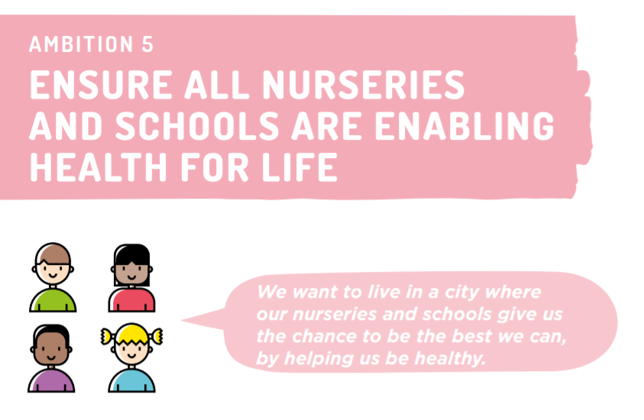
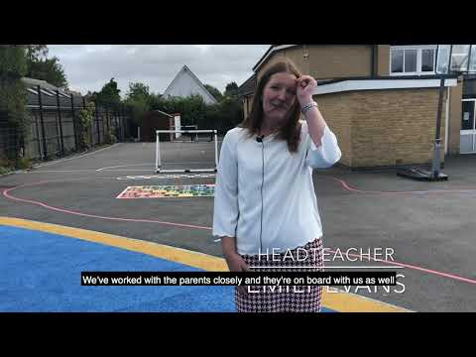

Healthy Schools Awards
Supporting all early years settings to achieve Healthy Early Years London awards
Target for all schools to be participating in the Daily Mile
Gold Food for Life served in 24 primary schools
Youth Games and School Sports awards
Weight management support delivered by Your Healthcare
Healthy Schools Awards
A total of 32 schools hold a Healthy Schools Award in Kingston with 32 Bronze, 14 Silver and 6 Gold.

Slide 53
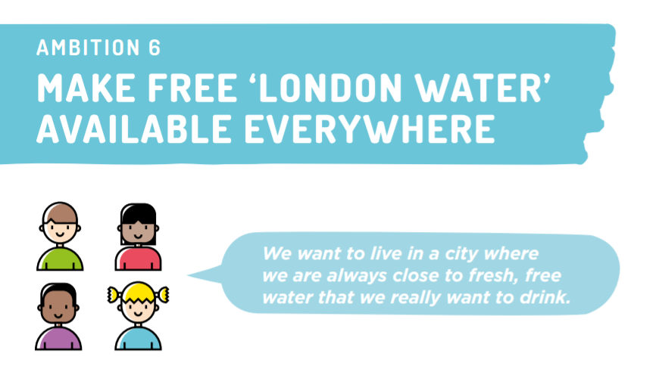
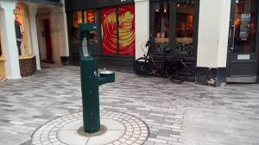
Marmot Principle: Create and develop healthy and sustainable places and communities
RBK has committed to providing water fountains throughout the borough.
Schools are encouraged to be ‘water only’ schools through the Healthy Schools Awards scheme and whole school food and drink policies.
Notes:
Scale up exisiting intiatives to make drinking water widely, freely and conspicuously available from publc drinking fountains, all restaurnts and public buildings, and in ‘water only’ schools

Slide 54
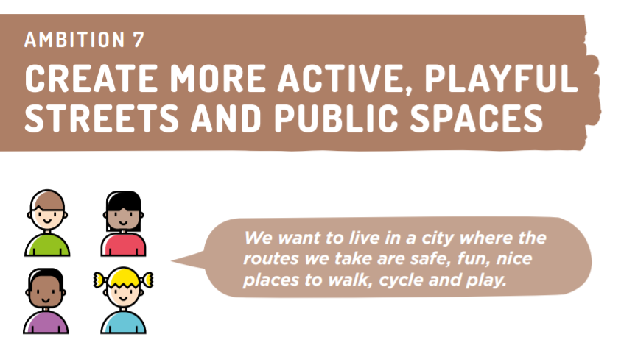
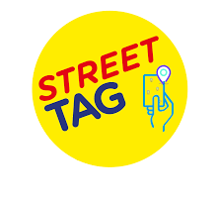

Street Tag - an initiative started in the borough in 2020 to get children and families to run and walk, using digital gamification to incentivise physical activity levels
School Streets Scheme. School streets are timed closures to motor traffic outside schools, usually during pick up and drop off times. RBK has trialled schemes locally.
Green Spaces & Parks Strategy 2021. RBK have invested over £1.3 million to deliver a wide range of sustainable improvements for public health benefit.
Leisure Facilities Strategy 2022. ‘Fit for purpose’ community sports facilities is a key priority for RBK and the new Leisure business plan.
Kingston Schools are participating in Street Tag’s Schools leaderboard.
In February 2022
1393 families participated and collected 44,109 tags.

Slide 55
Other initiatives to explore and do together to promote healthy weight, physical activity and tackle obesity in 2022/2023
1) Promoting physical activity and sustainable travel (Local Plan)
2) Promoting healthy eating campaigns and enabling healthy eating via workplaces, local businesses and making affordable healthy food available for all in our communities (Health Promotion Campaigns, working with businesses, Tackling Food Insecurity -Brite Box, Pantry, Cookery Classes)
3) Workforce development: Making Every Contact Count (Healthy Conversations) and encouraging people to take up available interventions and targeted weight management support (Vaccines and MECC)
4) Making free water available to all, everywhere (Focus on Water Only Schools)
5) Tackling inequalities by proportionately targeting population groups with poorer health outcomes (low income families, Black, asian and minority ethnic groups and young boys)
6) The Biggest Issue -finding out what is important to local people, what works for them?

Slide 56






We want to hear from our communities – what people feel about their weight and why, and what they would find helpful to support them to be a healthy weight

Slide 57


Slide 58

Talk to Healthwatch Kingston, Community Surgery
Do you have a question or concern about local NHS and social care services?

Slide 59


Healthwatch Kingston Update
  Bereavement Report published 18 Aug 2022
  Microsoft Word - Bereavement Services Report Final Draft V7[95].docx (healthwatchkingston.org.uk)
  ME. Pulse Check Survey opened –
  Pulse Check Survey - Myalgic Encephalopathy and Fibromyalgia | Healthwatch Kingston
  Virtual Wards Engagement Monday 26 Sept 2022- Available online
  A virtual conversation about virtual wards - update on event | Healthwatch Kingston
  Monitor the development of Primary Care Networks (PCN) lead, Patient Participation Groups (PPG)
  All about: The Integrated care systems (ICS) and Kingston Place | Healthwatch Kingston
  A Night to Remember. On 1st October staff and trustees walked 5 miles for Kingston Hospitals Bereaevement Support Services currently raising £640

